Slide 1


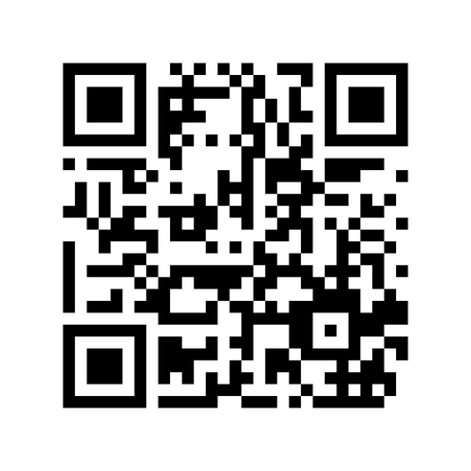
Sign In Code:
2525
SCAN THE ABOVE QR CODE BEFORE AND AFTER EACH PRESENTATION TO GET CE CREDIT

Slide 2
A New Way to Visualize Retirement Income Planning
Advanced Personal Financial Planning
Michael Finke
Professor and Frank M. Engle Chair of Economic Security
The American College of Financial Services
Notes:
Arial 16pt, body

Slide 3
2 big unknowns of retirement income planning
1) Don’t know how long you’ll live
2) Don’t know what investment returns will be

Slide 4
Understanding Longevity:
Probability You’ll Still Be Alive by Age
Healthy Female 50% at age 90
Average Male 50% at age 83

Slide 5
Longevity and the cost of funding safe income
Creating a bond ladder to 80th Percentile of longevity (20% failure rate)
Bond Yields on August 28, 2024

Slide 6
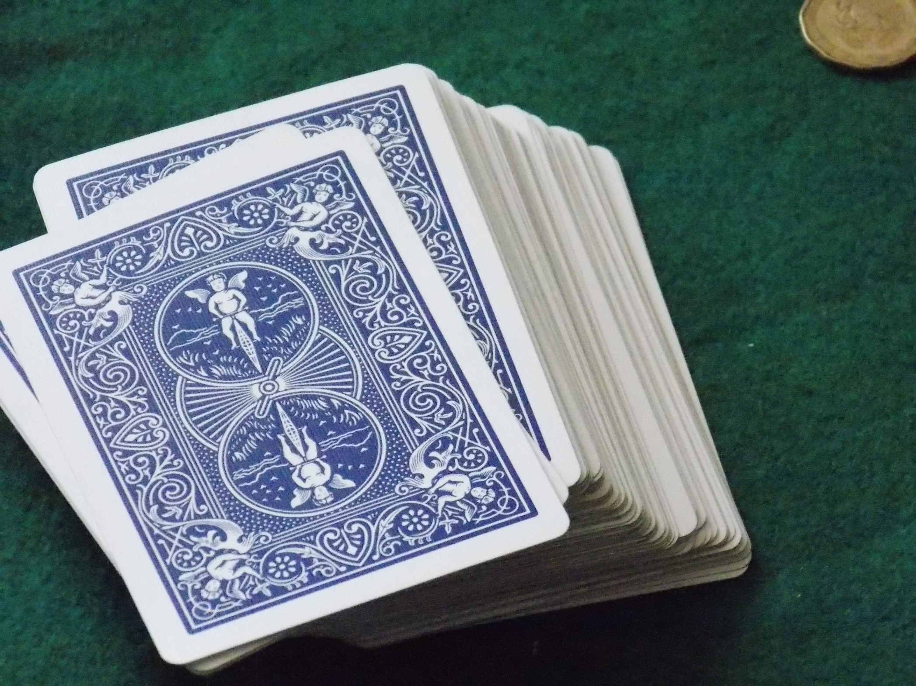
What hand of cards will you be dealt?
You have a deck of 40 cards at retirement
Each is an annual portfolio return
5%, 30%, -20%, etc.
Pick them up one at a time
This is what it means to invest in risky assets

Slide 7
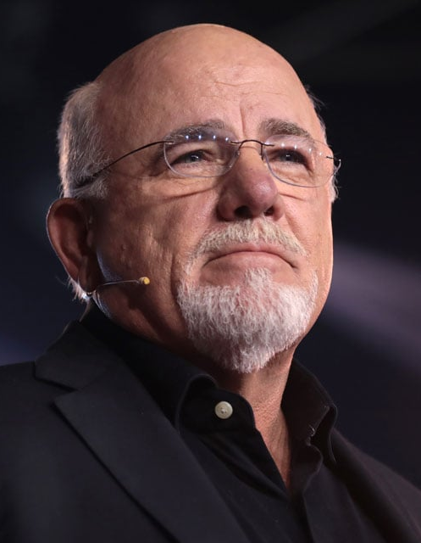
A Primer on Retirement Investing Risk
"If you're making 12 [percent] in good mutual funds and the S&P is averaging 11.8, and if inflation for the last 80 years is 4%, if you make 12 and you need to leave 4% in there for average inflation raises, that leaves you eight. So, I'm perfectly comfortable drawing eight. But if you want to be a little bit conservative, seven. But, sure, not five or three."

Slide 8
2000-2019 Large Stock Returns
(Average = 7.7%, Std deviation = 18.1%)
Morningstar SBBI US Large Stock Returns

Slide 9
Withdrawal of $55,000 nominal from $1 million stock portfolio starting in 2000
Morningstar SBBI US Large Stock Returns

Slide 10
Withdrawal of $55,000 nominal from $1 million stock portfolio starting in 2003
Morningstar SBBI US Large Stock Returns

Slide 11
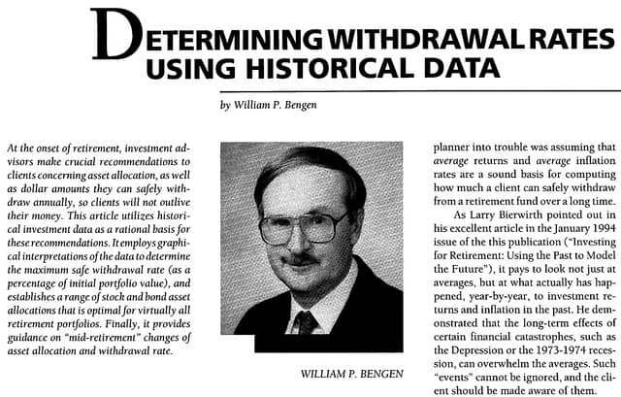
Retirement through the “failure rate” lens

Slide 12
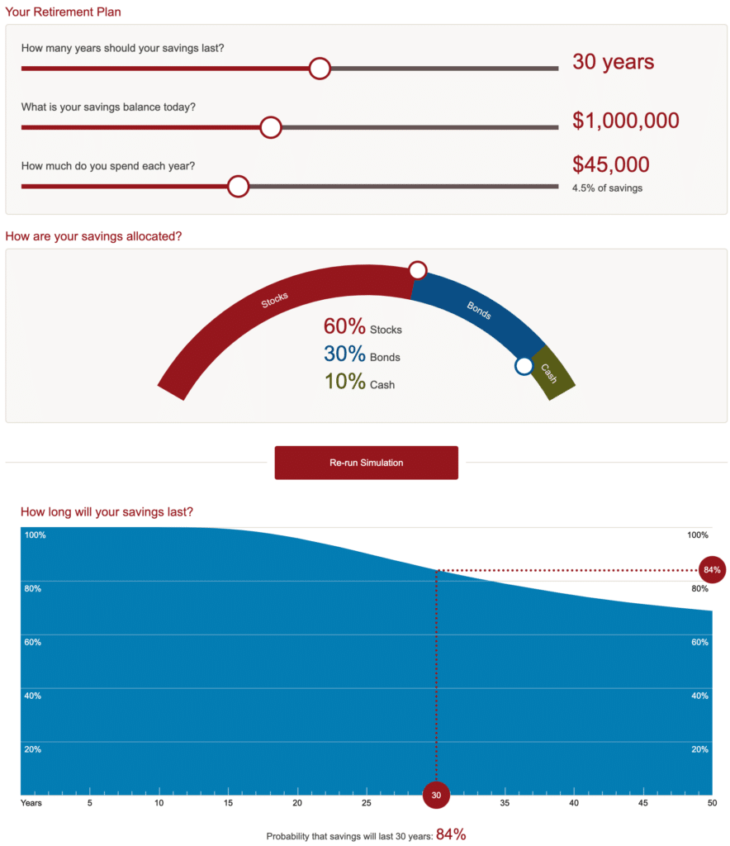
What does an 84% probability of success mean?
Notes:
84% suggests a level of precision that does not exist in reality
What is the objective? Increasing success by spending less? Increasing investment risk? How does this help people make better decisions about spending/risk? Hard to intuit, not directly actionable.

Slide 13
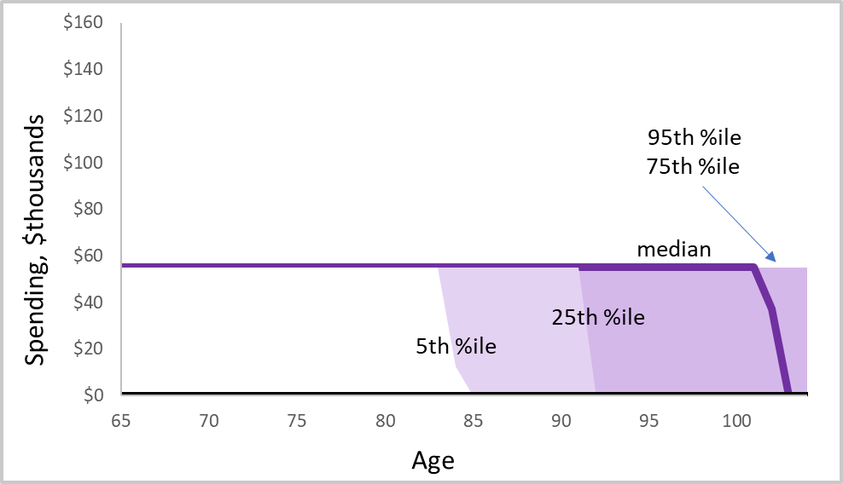
Illustration of a fixed withdrawal rate rule
$1m portfolio, $55k income, 40/60 allocation, 1% AUM

Slide 14
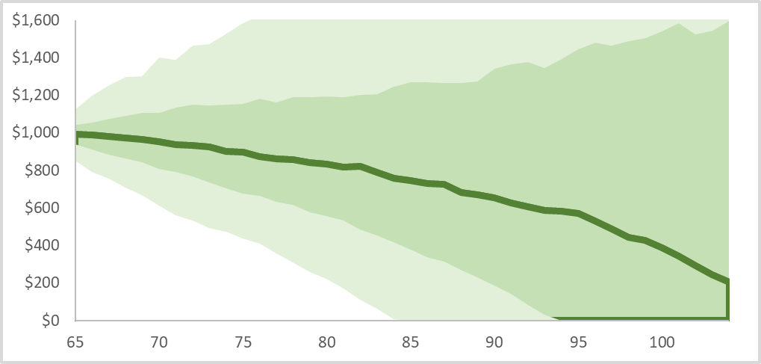
Legacy values with a fixed withdrawal rate rule
95th Percentile
75th Percentile
Median
Legacy $000’s
25th Percentile
5th Percentile

Slide 15
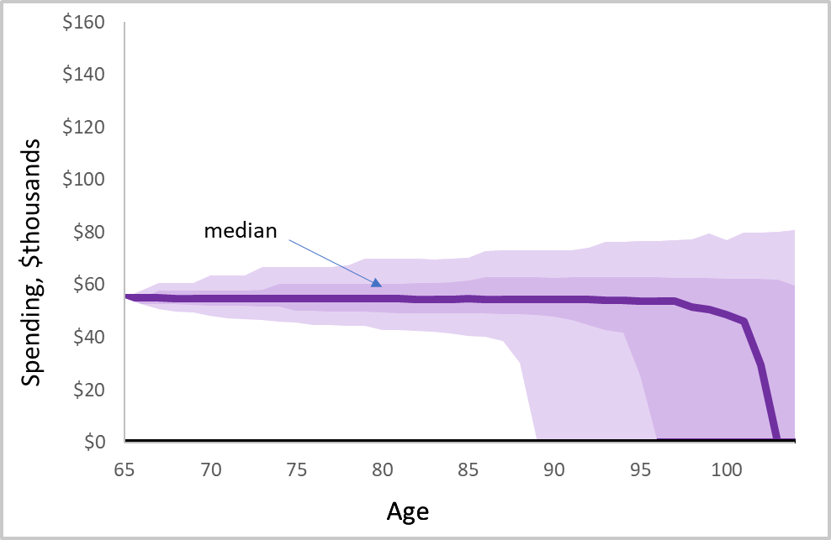
Modest Guardrail Strategy
Adjust spending to 5% total change depending on asset returns
Upside adjustment limited by guardrail
Constraining flexibility = some failure

Slide 16
Longevity risk with an investment portfolio
Healthy 95-year old woman
Age 95
$500,000 wealth for income goal
Age 96, 81% still alive
Age 97, 64% still alive
How do you allocate the $500,000?
Age 98, 49% still alive
Age 99, 36% still alive
Age 100, 25% still alive
Age 101, 17% still alive

Slide 17
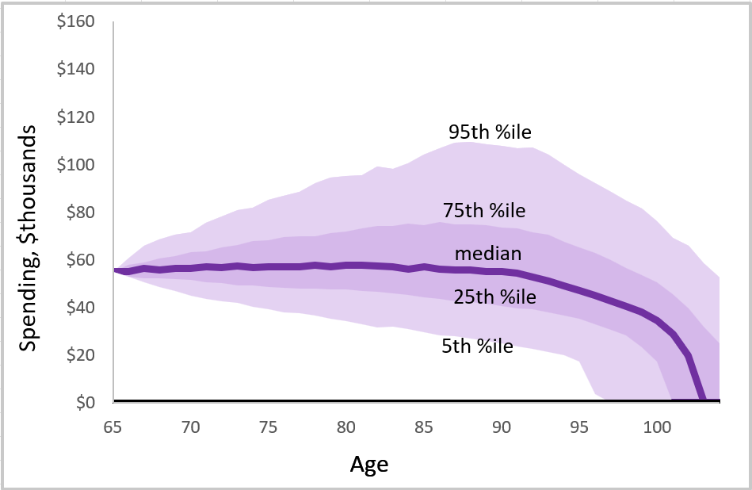
Unconstrained Annual Adjustment (RMD-style)
Current balance/expected remaining longevity
Spending rises early in retirement
Spending falls late in retirement

Slide 18
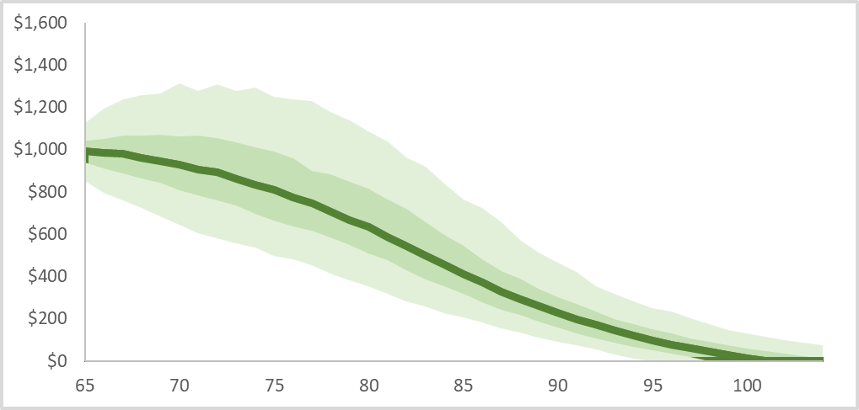
Unintended bequests and withdrawal method
If the purpose of this wealth is income, RMD method is pretty efficient

Slide 19
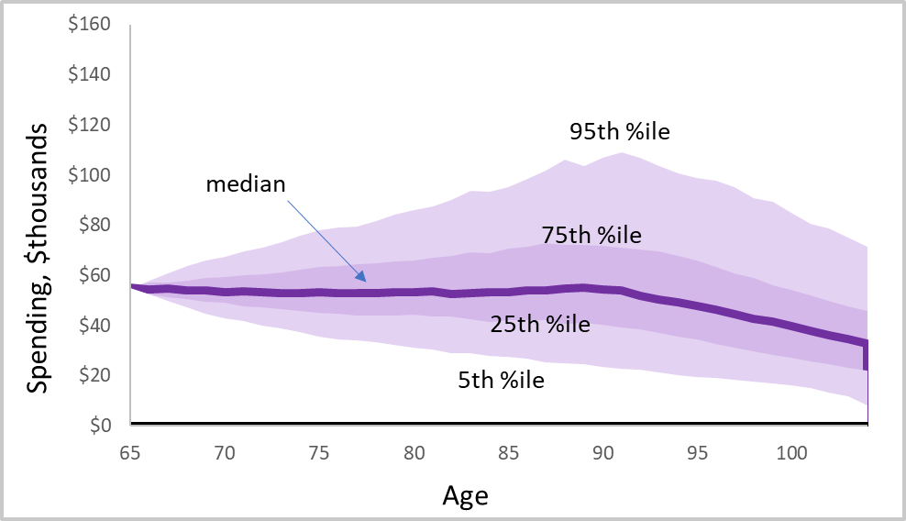
5% Annual Spending Constraint (unlimited lifetime constraint)
Annual change determined by algo based on longevity and assets
Eliminates Failure

Slide 20
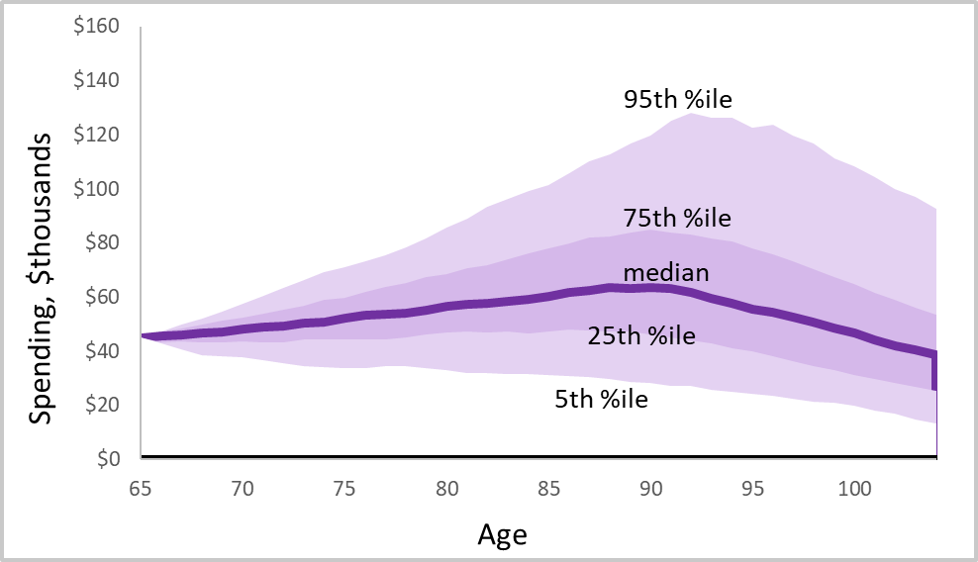
Lower Initial Spending Goal (4.5%) Increases Spending Slope
Spending increases determined by performance, not inflation
For unlucky retirees, adjusting by inflation could result in failure

Slide 21
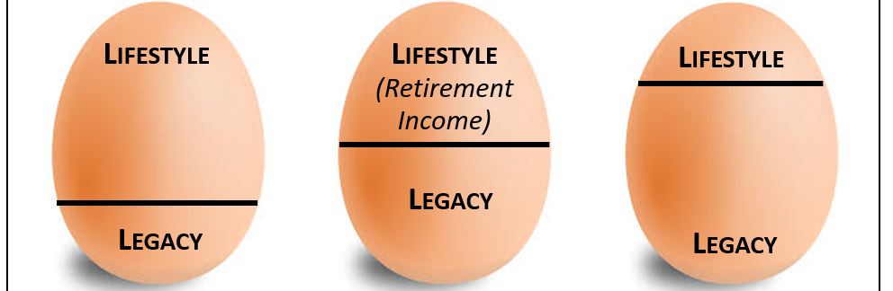

Setting Lifestyle and Legacy Goals
Initiate a conversation about the importance of legacy vs. lifestyle

Slide 22
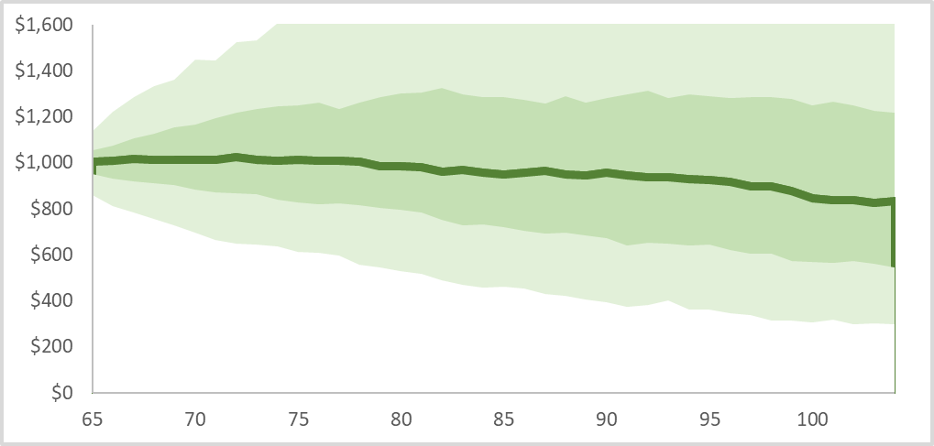
Lower initial income increases legacy values
Or, leads to higher unintended bequest

Slide 23
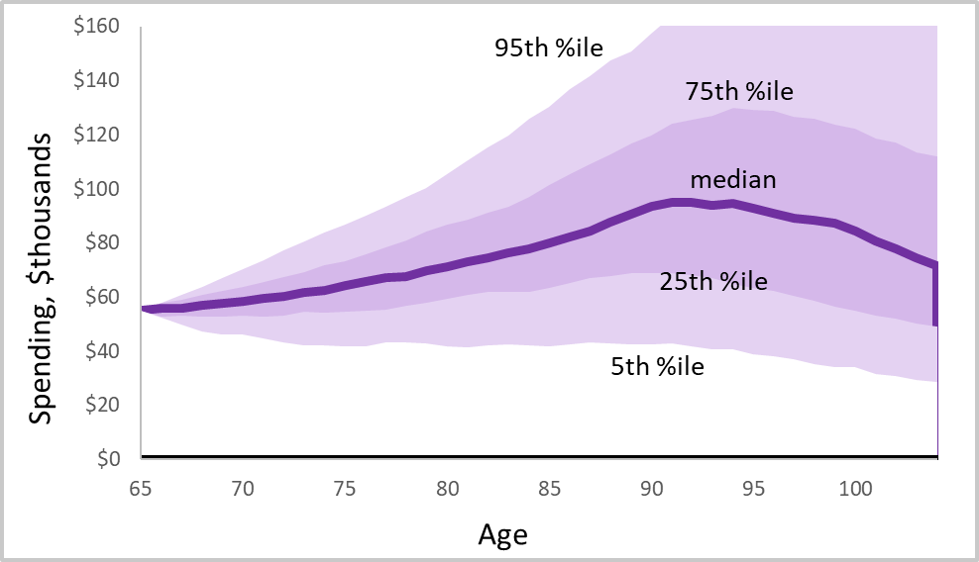
Asset Return Expectations Drive Spending Paths
Optimistic: 12% return on stocks, 6% return on bonds

Slide 24
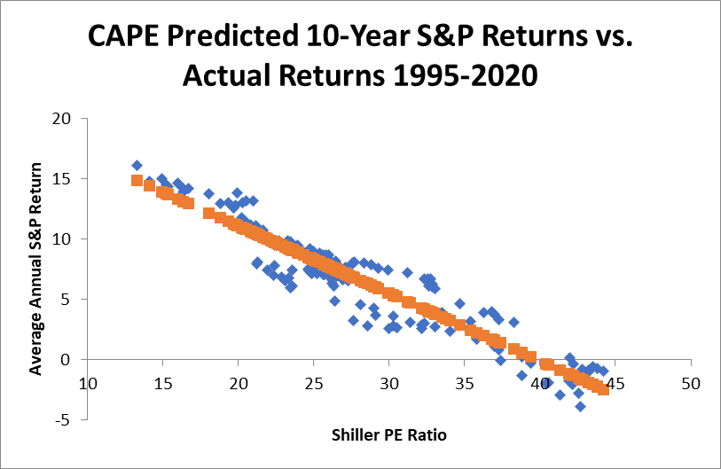
Estimating 10-Year Expected Equity Returns
We are here today
Source: Finke and Blanchett, 2020

Slide 25
Investment risk
Historical future value of $1 in 20 years
Source: Ibbotson Stocks, Bills, Bonds, and inflation index 1926-2024. Short-term, intermediate term, and long-term treasury bonds and S&P 500 index including dividends
16
Notes:
Before the mid-1950s, a retiree who invested in stocks would have always had much more money in the future than if she invested in bonds. However, recent returns for stocks have not been consistently higher than some types of bonds and retirees who invested $1 for 20 years after 1988 were not able to receive the same reward for taking investment risk that previous generations of Americans were able to receive. Return data through September 2024.

Slide 26
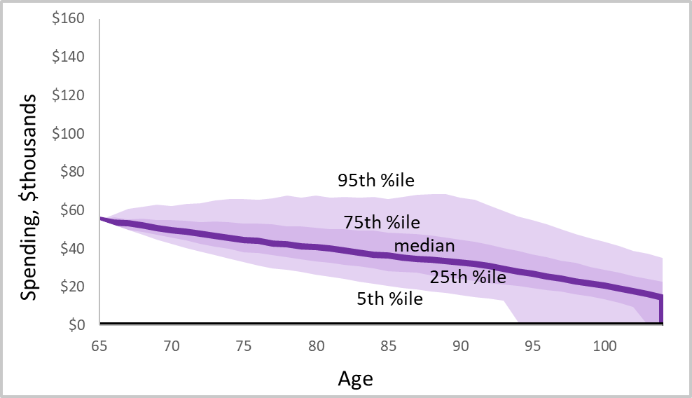
Pessimistic Future Asset Returns
6% equities, 3% bonds (or 7% equities, 4% bonds and 1% AUM)
Probably going to want to start with a lower initial spending goal

Slide 27

Addressing longevity risk

Slide 28
Cost of Doing it Yourself Vs. Mortality Pooling
Finke, 2020
29
Notes:
This is the annual cost of buying income through Treasury bonds versus buying income through a mortality pooling mechanism using mortality tables for a 65-year old female. Yellow line is simply the PV of $15,000 discounted by the Treasury rate multiplied by the probability of being alive.

Slide 29
What mortality risk pooling allows you to do
Spend more from longevity-protected bond portfolio (annuity)
Spend less from remainder of portfolio to meet income goal
Take more optimal investment risk with remaining portfolio
Example $400,000 annuity with 6.5% payout rate = $26,000 of $50,000 goal
  Vs. taking 5.5% of $400,000 bond portfolio ($26k - $22k = $4k less from remainder)

Slide 30
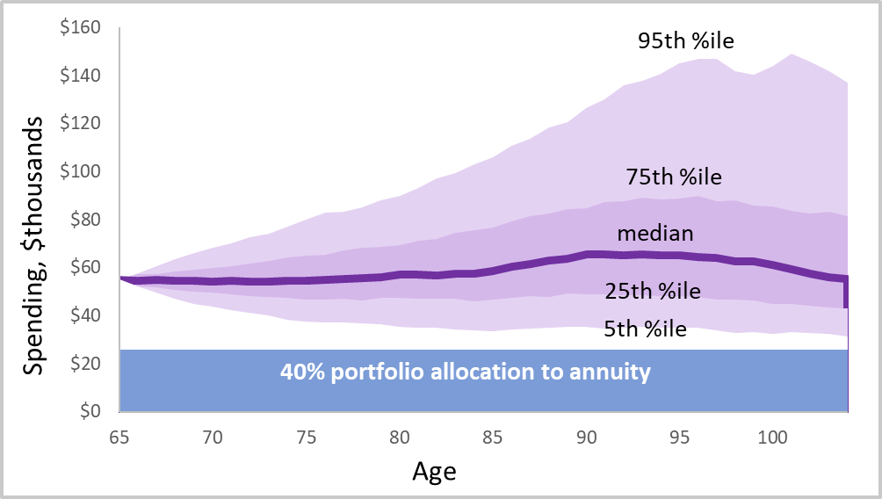
Substituting Annuities for Bonds in Retirement Portfolio
40% annuity, 6.5% payout rate, 67% equities in remaining portfolio

Slide 31
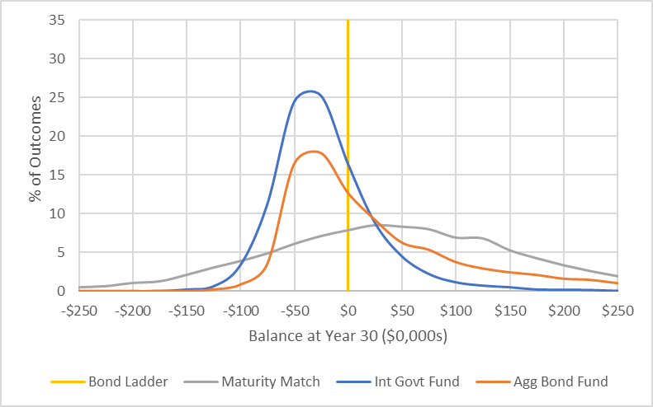
The Other Advantage of Income Annuities over Bond Funds
They are a bond ladder with mortality credits
Bond Funds that Run out Funding Constant Spending Goal
Source: Blanchett and Finke, 2024

Slide 32

How transferring longevity risk affects income paths
Increased spending at every age at every percentile

Slide 33

Thank You.
TheAmericanCollege.edu
Notes:
RICP Specific Thank You

Slide 34
Sign Out Code:
2526
SCAN THE ABOVE QR CODE BEFORE AND AFTER EACH PRESENTATION TO GET CE CREDIT

