Slide 1
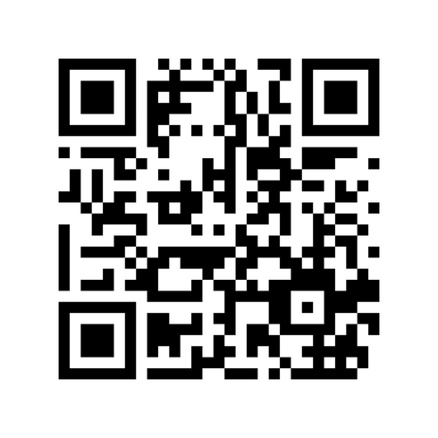
Sign In Code:
7676
SCAN THE ABOVE QR CODE BEFORE AND AFTER EACH PRESENTATION TO GET CE CREDIT

Slide 2
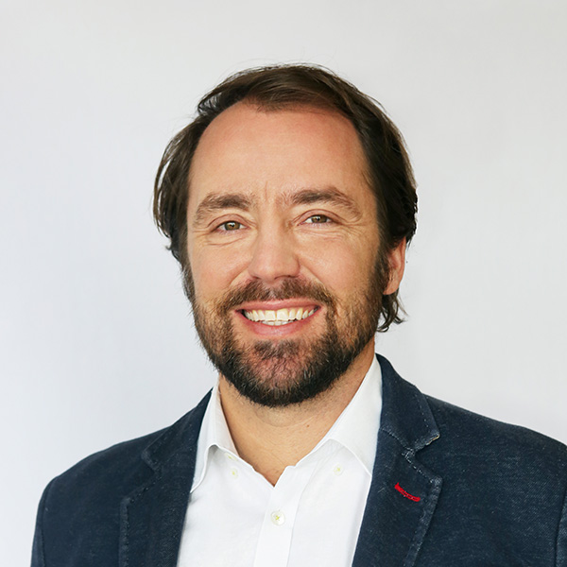
Macro with Meb
A Warning
A Solution
A Curiosity
Something You Never Heard Of
Meb Faber

Slide 3
Funds
Cambria Funds cambriafunds.com
Research
The Idea Farm theideafarm.com
Twitter
@MebFaber
3

Slide 4
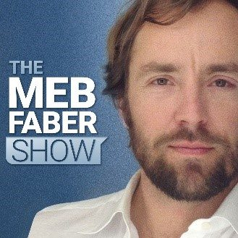
Blog
MebFaber mebfaber.com
Podcast
The Meb Faber Show mebfaber.com/podcast
4

Slide 5
Cambria Shareholder Yield Suite of ETFs
 | Ticker | Inception Date | Benchmark Index | Total Expenses | Strategy | Rebalanced
Cambria Shareholder Yield ETF | SYLD | 5/14/13 | S&P 500 Index | 0.59% | Targets top 100 companies ranked by shareholder yield, valuation, and quality metrics in the US. | Quarterly
Cambria Foreign Shareholder Yield ETF | FYLD | 12/3/13 | MSCI EAFE Index | 0.59% | Targets top 100 companies ranked by shareholder yield, valuation, and quality metrics in foreign developed markets | Quarterly
Cambria Emerging Shareholder ETF | EYLD | 7/14/16 | MSCI Emerging Markets Index | 0.63% | Targets top 100 companies ranked by shareholder yield, valuation, and quality metrics in in emerging markets. | Quarterly
Cambria Micro and Small Cap Shareholder Yield ETF | MYLD | 1/4/24 | S&P Small Cap 600 Index | 0.87% | Targets top 100 companies ranked by shareholder yield, valuation, and quality metrics in the US. | Quarterly
Cambria Large Cap Shareholder Yield ETF | LYLD | 7/12/24 | S&P 500 Index | 0.59% | Targets top 100 companies ranked by shareholder yield, valuation, and quality metrics in the US. | Quarterly
The Cambria ETFs are distributed by ALPS Distributors Inc., 1290 Broadway, Suite 1000, Denver, CO 80203, which is not affiliated with Cambria Investment Management, LP, the Investment Adviser for the Fund.
Shares are bought and sold at market price (closing price) not net asset value (NAV) and not individually redeemed from the Fund. Market price returns are based on the midpoint of the bid/ask spread at 4:00pm Eastern Time (when NAV is normally determined), and do not represent the return you would receive if you traded at other times.
5
Notes:
Cambria Shareholder Yield Suite

Slide 6
A Warning….
6

Slide 7
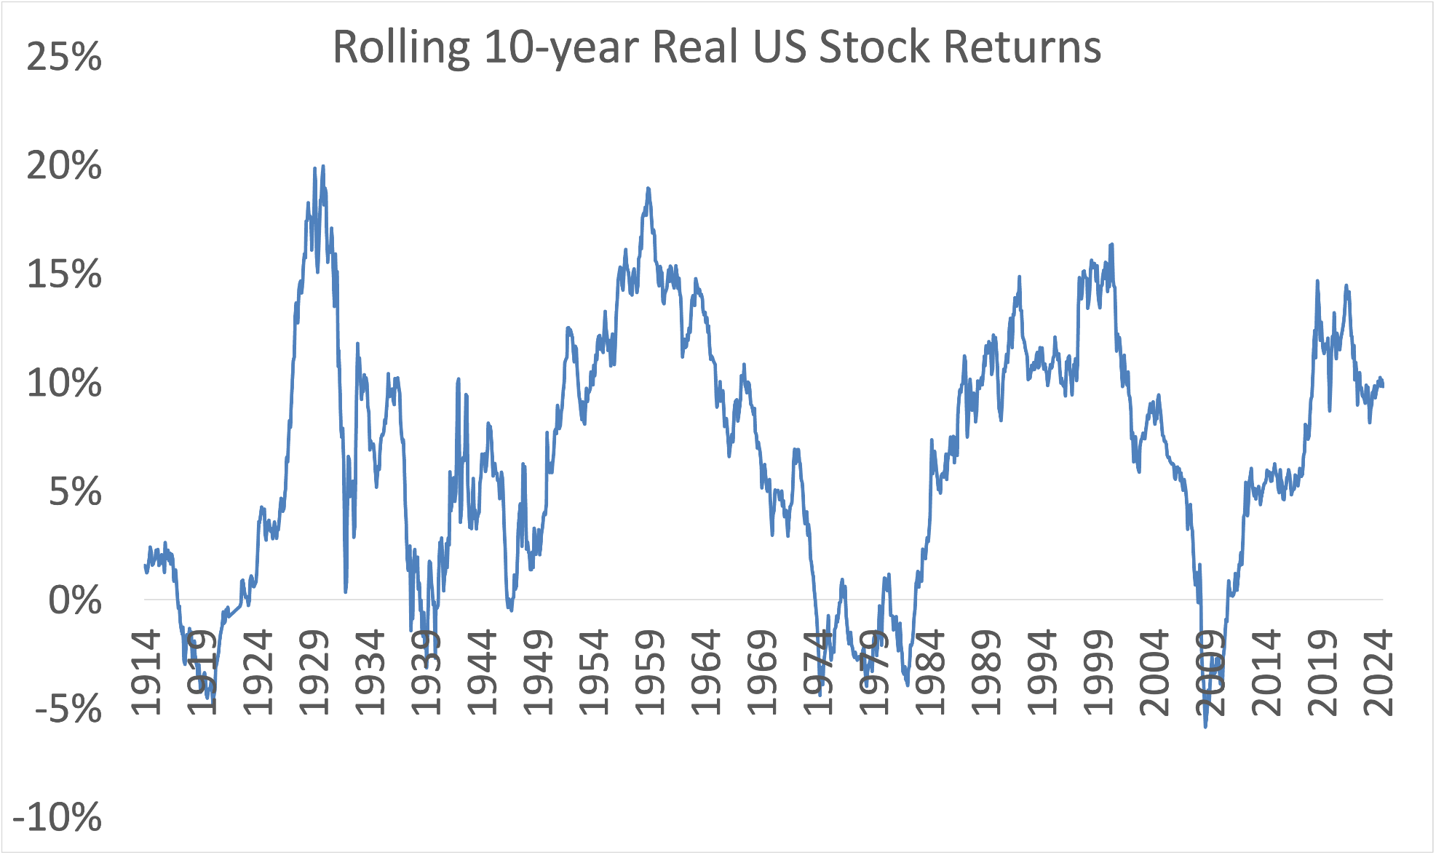
US Stocks Over Time
Source: Cambria, Global Financial Data, as of 2/28/2025. Past performance does not guarantee future results.
7
Notes:
Needs to be updated as of 4/20/25

Slide 8
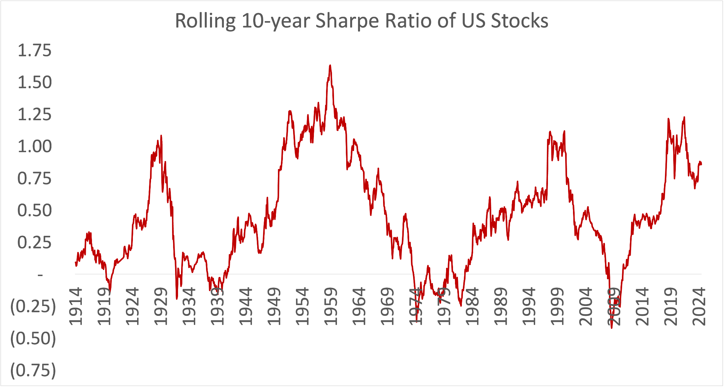
US Stocks Over Time
Source: Cambria, Global Financial Data, as of 2/28/2025. Past performance does not guarantee future results.
8
Notes:
Needs to be updated as of 4/20/25

Slide 9
US Stocks Over Time
Source: YCharts, Robert Shiller, as of 3/31/2025. Past performance does not guarantee future results.
9
Notes:
Shiller CAPE Ratio for US Stocks.
Updated March 31 2025

Slide 10
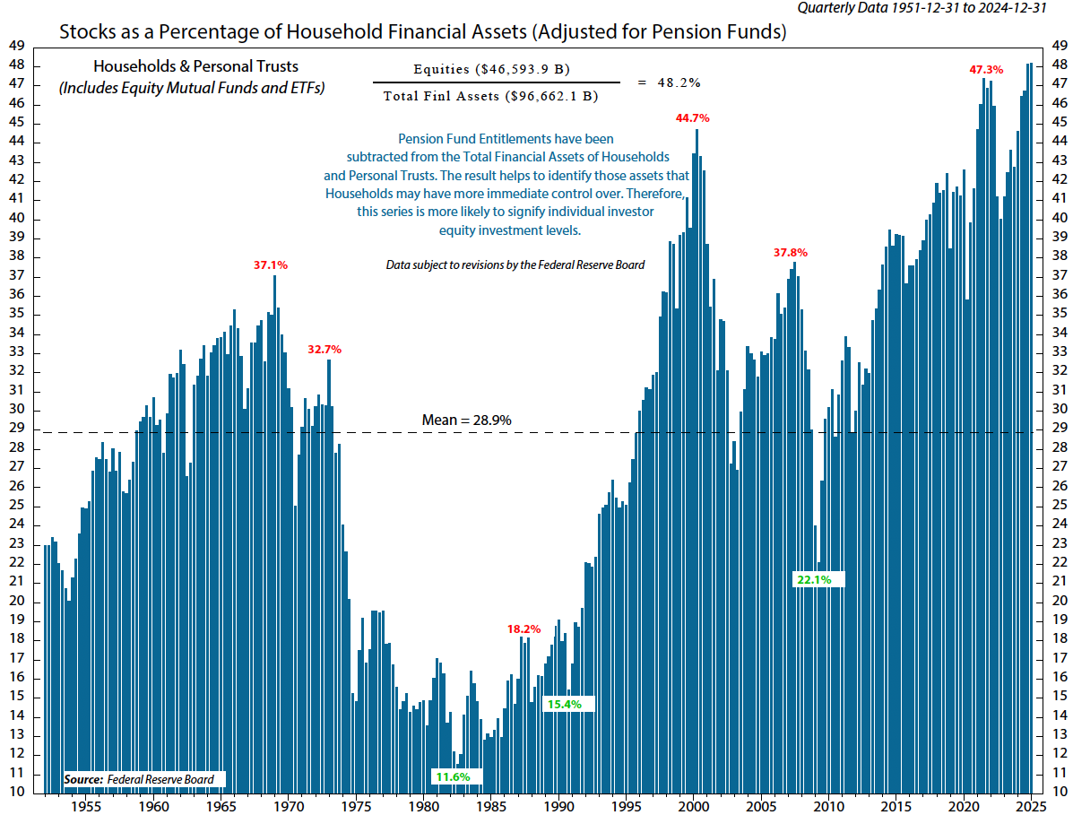
Source: Ned Davis Research
10

Slide 11
Apple
Magnificent Seven
Country Weights
Source: MSCI, Cambria. As of March 31, 2025.
11

Slide 12
A Solution….
12

Slide 13
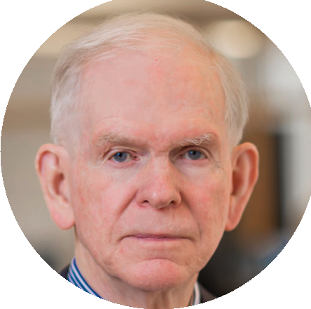
“You don’t get rewarded for taking risk; you get rewarded for buying cheap assets. And if the assets you bought got pushed up in price simply because they were risky, then you are not going to be rewarded for taking a risk; you are going to be punished for it.”
Jeremy Grantham
13
Notes:
Buffett on buybacks

Slide 14
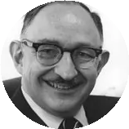
“I view diversification not only as a survival strategy but as an aggressive strategy because the next windfall might come from a surprising place.”
Peter Bernstein
14
Notes:
Buffett on buybacks

Slide 15
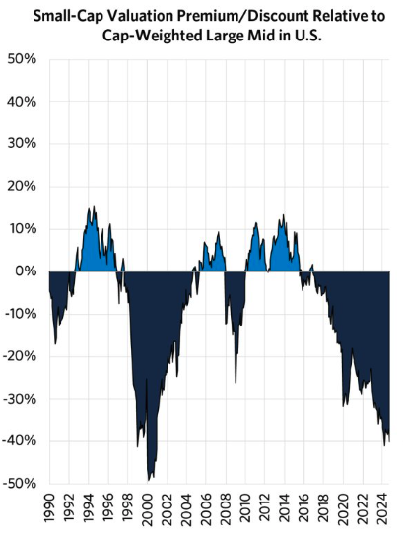
Source: Research Affiliates; March 1990 – December 2024.
15
Notes:
Needs to be updated as of 4/20/25

Slide 16
Source: Global Financial Data. As of February 28, 2025.
16
Notes:
Needs to be updated as of 4/20/25

Slide 17
Global Valuations
 | CAPE Ratio
USA | 35
Foreign Developed | 19
Foreign Emerging | 14
Cheapest 25% | 11
Source: Global Financial Data, Ned Davis Research, valuations based on CAPE ratios as of March 31st, 2025
17

Slide 18
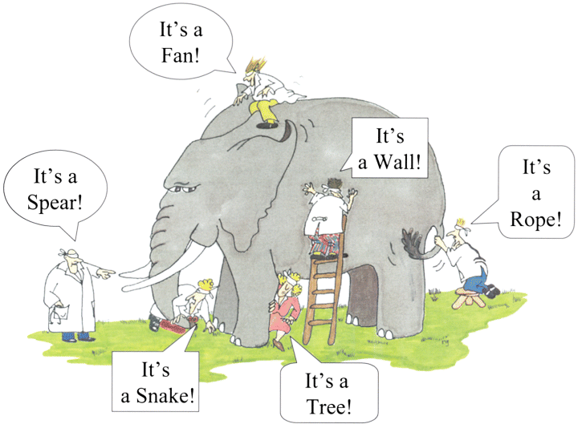
How Can a Company Maximize Return On Investment?
Cash Dividend
Buyback Stock
Pay Down Debt
Mergers & Acquisitions
Reinvest in the Business
18
Notes:
Today we’ll talk about Shareholder Yield.

Slide 19
Why a Shareholder Yield Strategy
19
Notes:
Warren Buffett on why buybacks should be considered

Slide 20
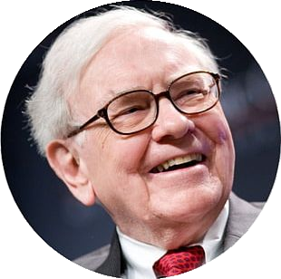
Why Buybacks Should Be Considered
“When companies with outstanding businesses and comfortable financial positions find their shares selling far below intrinsic value in the marketplace, no alternative action can benefit shareholders as surely as repurchases.”
Warren Buffett
(1984 Letter to Berkshire Hathaway shareholders)
20
Notes:
Buffett on buybacks

Slide 21
The Cambria Shareholder Yield ETF
21
Notes:
The process behind the Cambria Shareholder Yield ETF (SYLD)
The fund emphasizes a return to shareholders through both dividends and buybacks, a concept referred to as shareholder yield

Slide 22
For Any Remaining Skeptics
22
Notes:
O’Shaughnessy on buybacks

Slide 23
A Curiosity….
23
Notes:
Rolling 10 year US stock returns
Updated Jan 2024

Slide 24
Tbills and Chill
24
Notes:
If you don’t want the photo just delete it, t-bills and chill is behind the image

Slide 25
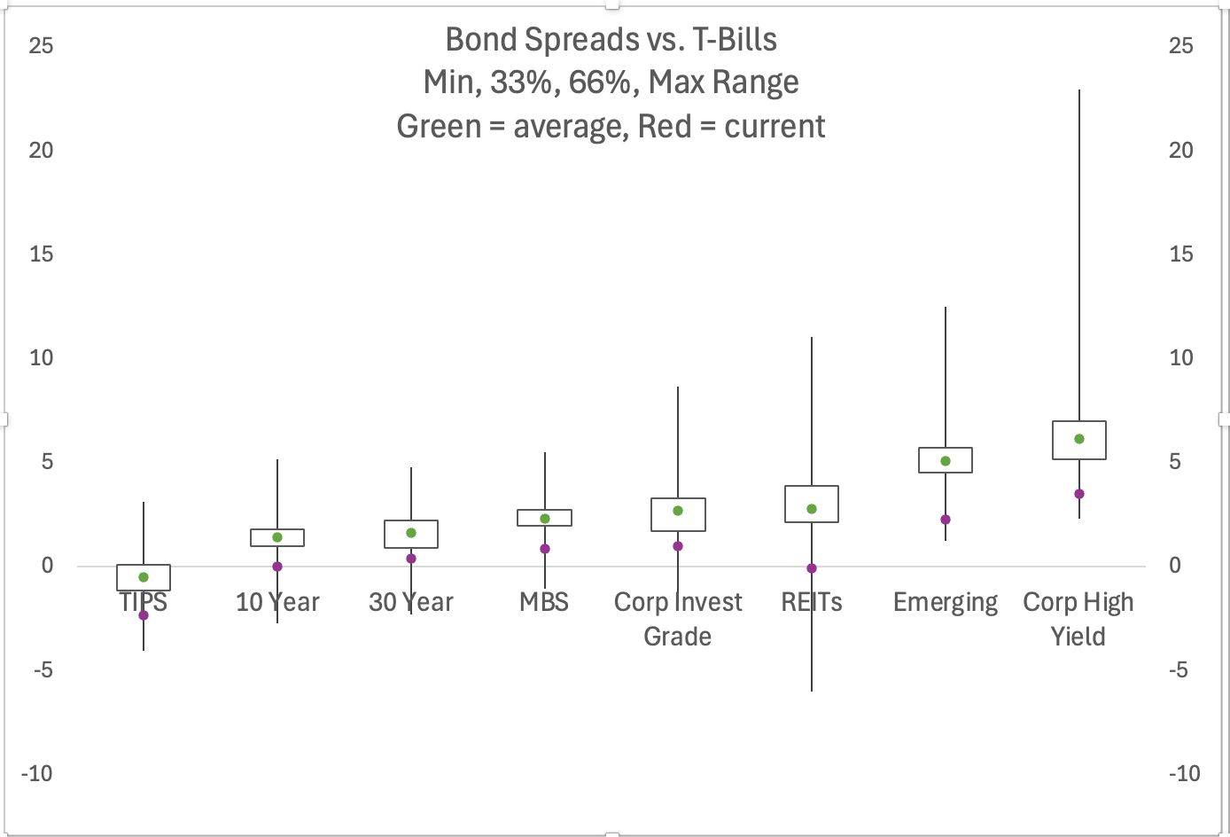
Yield Spread vs. T-Bills
Yield Spread vs. T-Bills
Source: Cambria, Global Financial Data, as of 3/31/2025
25

Slide 26
Something You Never Heard Of
26
Notes:
Rolling 10 year US stock returns
Updated Jan 2024

Slide 27
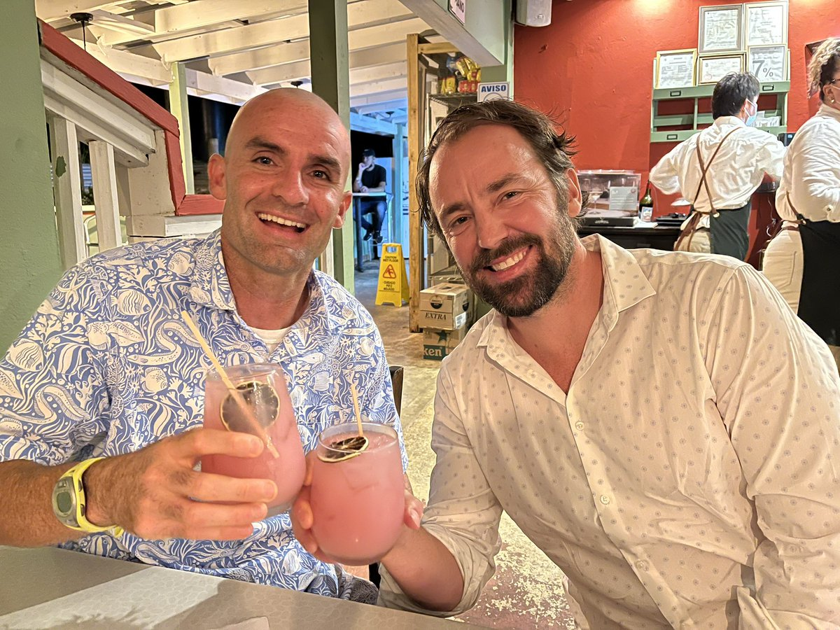
351 to ETF Contribution
27

Slide 28
351 to ETF Exchange Overview
Contribute an investment portfolio
“Seed” the launch of an ETF
Receive a diversified ETF in exchange
Tax Deferred
* ETFs are analyzed on a look-through basis
28
Notes:
Update formatting

Slide 29
Tax-Free Transfer Limitations
Contributed portfolios must be diversified:
No single position > 25% (ETFs are exempt from this requirement*)
Not more than 50% of the value can be in 5 or fewer issuers
>= 12 positions is the minimum number of positions
You cannot make on-going contributions to the ETF
* ETFs are analyzed on a look-through basis
29
Notes:
Update formatting

Slide 30
Example Portfolios That Do Not Qualify
An investor wants to contribute a portfolio consisting of 50% Nvidia stock and 50% cash
An investor with a portfolio of mutual funds
An investor with a portfolio of DogeCoin
30
Notes:
No changes from TAX webinar deck

Slide 31
Contact Us
To learn more about Cambria, connect with us at:
info@cambriafunds.com
3300 Highland Avenue
Manhattan Beach, CA 90266
(310) 683-5500
www.cambriafunds.com
31
Notes:
Get in touch with us
Thank you

Slide 32
Disclosure
To determine if this Fund is an appropriate investment for you, carefully consider the Fund’s investment objectives, risk factors, charges and expense before investing. This and other information can be found in the Fund’s full and summary prospectus which may be obtained by calling 855-383-4636 (ETF INFO) or visiting our website at www.cambriafunds.com. Read the prospectus carefully before investing or sending money.
The Cambria ETFs are distributed by ALPS Distributors Inc., 1290 Broadway, Suite 1000, Denver, CO 80203, which is not affiliated with Cambria Investment Management, LP, the Investment Adviser for the Fund.
ETFs are subject to commission costs each time a “buy” or “sell” is executed. Depending on the amount of trading activity, the low costs of ETFs may be outweighed by commissions and related trading costs.
Shares are bought and sold at market price (closing price) not net asset value (NAV) are not individually redeemed from the Fund. Market price returns are based on the midpoint of the bid/ask spread at 4:00 pm Eastern Time (when NAV is normally determined), and do not represent the return you would receive if you traded at other times. Buying and selling shares will result in brokerage commissions. Brokerage commissions will reduce returns.
32

Slide 33
Disclosure
There is no guarantee that the Fund will achieve its investment goal. Investing involves risk, including the possible loss of principal. High yielding stocks are often speculative, high risk investments. The underlying holdings of the fund may be leveraged, which will expose the holdings to higher volatility and may accelerate the impact of any losses. These companies can be paying out more than they can support and may reduce their dividends or stop paying dividends at any time, which could have a material adverse effect on the stock price of these companies and the Fund’s performance. International investing may involve risk of capital loss from unfavorable fluctuations in currency values, from differences in generally accepted accounting principles, or from economic or political instability in other nations. Emerging markets involve heightened risks related to the same factors as well as increased volatility and lower trading volume. Investments in smaller companies typically exhibit higher volatility. Narrowly focused funds typically exhibit higher volatility.
The Fund is managed using proprietary investment strategies and processes. There can be no guarantee that these strategies and processes will produce the intended results and no guarantee that the Fund will achieve its investment objective. This could result in the Fund’s underperformance compared to other funds with similar investment objectives.
There is no guarantee dividends will be paid. Diversification may not protect against market loss.
There are special risks associated with margin investing. As with stocks, you may be called upon to deposit additional cash or securities if your account equity declines.
Indicative value (iNAV) is a measure of the intraday net asset value (NAV) of an investment. It is reported approximately every 15 seconds and gives investors a measure of the value of the investment throughout the day.
© 2024 Morningstar, Inc. All Rights Reserved. The information contained herein: (1) is proprietary to Morningstar and/or its content providers; (2) may not be copied or distributed; and (3) is not warranted to be accurate, complete or timely. Neither Morningstar nor its content providers are responsible for any damages or losses arising from any use of this information. Past performance is no guarantee of future results.
33

Slide 34
Disclosure
Definitions
EBITDA: Earnings before interest, taxes, depreciation, and amortization. It is a metric used to evaluate company earnings (income).
Dividends: The distribution of reward from a portion of the company’s earnings and is paid to a class of its shareholders. Dividends can be issued as cash payments or as shares of stock, though cash dividends are the most common.
Buybacks: Also known as share repurchase. When a company buys its own outstanding shares to reduce the number of shares available on the open market, thus increasing the proportion of shares owned by investors. Companies buy back shares for a number of reasons, such as to increase the value of remaining shares available by reducing the supply or to prevent other shareholders from taking a controlling stake.
30-Day SEC Yield: A standard yield calculation developed by the U.S. SEC that is based on the most recent 30-day period.
The price/earnings ratio (P/E Ratio) is the ratio of a company's stock price to the company's per share earnings.
The price/book ratio (P/B Ratio) is the ratio of a company's stock price to the company's book value.
The price/sales ratio (P/S Ratio) is the ratio of a company's stock price to the company’s revenue.
The price/cash flow ratio (P/CF Ratio) is the ratio of a company’s stock price to the company’s per share cash flow.
The price/free cash flow ratio (P/FCF Ratio) is the ratio of a company's stock price to the company's per share free cash flow.
ǂ When evaluating the Morningstar category average valuation metrics (Price/Earnings, Price/Book, Price/Sales, Price/Cash Flow, Price/Free Cash Flow), because these metrics are redundant for each fund share class, we use Morningstar’s option of “User Defined Primary Class Only” to prevent multishare funds from having a disproportionate impact on the category average. The category average 30-day SEC Yield is the exception in this table and is calculated based on all funds in the category.
CBM001975
34

Slide 35
Disclosure
Definitions
S&P 500 Index: The S&P 500 Index is an index of 500 stocks chosen for market size, liquidity and industry grouping, among other factors. The S&P 500 is designed to be a leading indicator of U.S. equities and is meant to reflect the risk/return characteristics of the large cap universe.
Sharpe Ratio: The Sharpe Ratio is a measure of risk-adjusted return, indicating how much excess return an investment generates for each unit of risk taken.
Shiller CAPE Ratio (Cyclically Adjusted Price-to-Earnings Ratio): The Shiller CAPE Ratio is a valuation metric that assesses whether a stock or the broader market is overvalued or undervalued. It is calculated by dividing the current price of a stock or index by the average of inflation-adjusted earnings over the past 10 years.
MSCI ACWI Index (MSCI All Country World Index): The MSCI All Country World Index (ACWI) is a global equity index that measures the performance of large and mid-cap stocks across both developed and emerging markets.
CBM001975
35

Slide 36
Sign Out Code:
7677
SCAN THE ABOVE QR CODE BEFORE AND AFTER EACH PRESENTATION TO GET CE CREDIT

