Slide 1
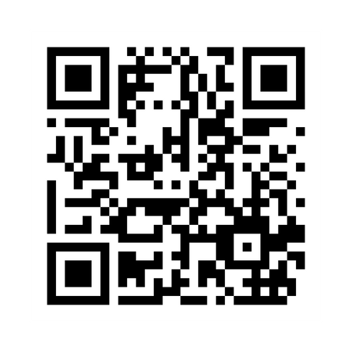
Sign In Code:
2112
SCAN THE ABOVE QR CODE BEFORE AND AFTER EACH PRESENTATION TO GET CE CREDIT

Slide 2
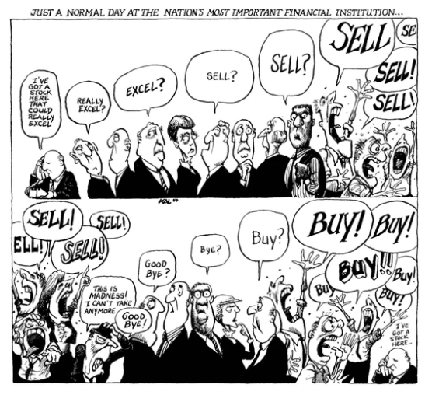
Risk & Reward

Slide 3
Agenda
1. Some stories about risk and reward.
2. How to manage risk.
3. Some thoughts on the current risks.

Slide 4
Shark Week
Notes:
First appeared on the Discovery Channel 1988
Researchers performed a study of different groups of people to record how watching Shark Week would affect their perception of sharks.
The more people watched of Shark Week the more scared they became of sharks.
This was the case even when statistics were given about how few shark attacks there are every year.
People don’t respond to statistics. They do respond to video of an enormous animal with a scary fin and huge teeth that could potentially rip you to shreds.

Slide 5
Deadliest Animals

Slide 6
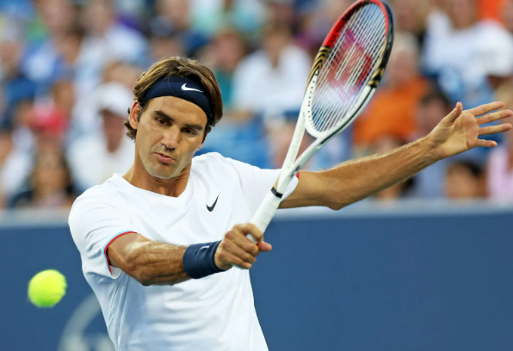
The Other Fed
1,526 singles matches
Won 80% of his matches
Won 54% of his points in those matches
Notes:
Dartmouth commencement address:
“In tennis perfection is impossible…”
Played 1,526 singles matches in his career
Won 80% of those matches which is an insane long-term track record over a 24-year career
He asked the crowd: What percentage of points do you think I won in those matches?
54%!
Of course my stock market brain immediately realized – this is the stock market!
Incredible long-term win rate but over the short-term it’s much closer than you think

Slide 7
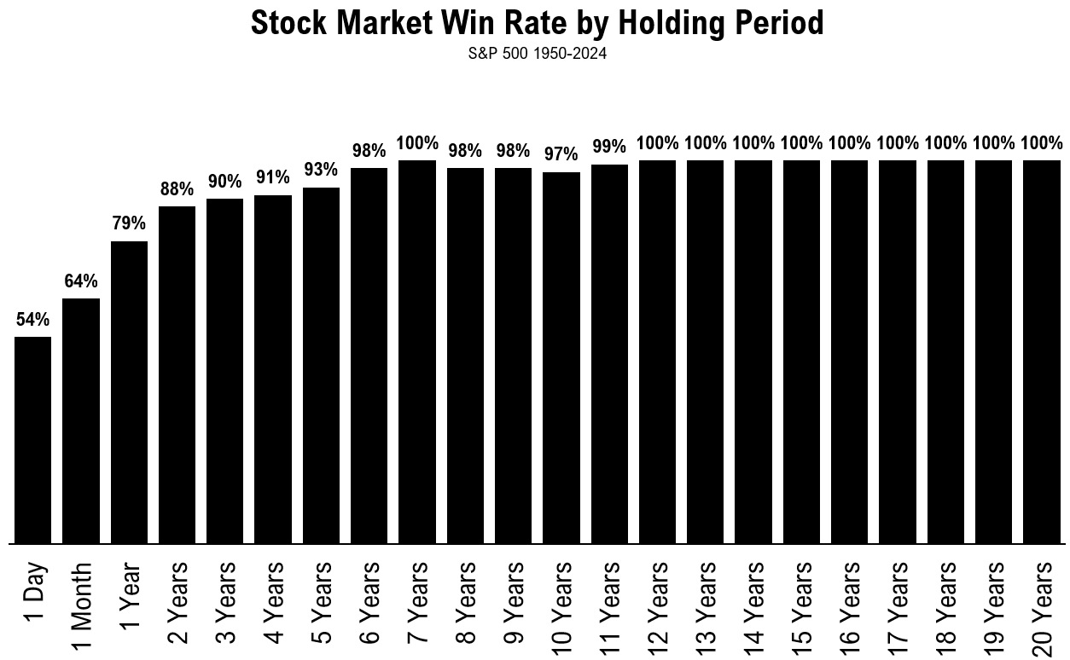
Best Casino Ever
Notes:
Some people like to say the stock market is just like a casino
If that’s so it’s the best casino ever created
The odds are stacked against you at the casino. The house has a slight edge
So the longer you stay the higher the likelihood you’ll lose (unless you are amazing at Blackjack like me – I am an amazing Blackjack player – best game there is)
The stock market is the opposite!
The longer you stay invested the higher your chances of experiencing a gain!
Let’s keep the tennis analogies going

Slide 8
The Most Important Concept
A win doesn’t feel as good as a loss feels bad, and the good feeling doesn’t last as long as the bad. Not even close.
-Andre Agassi
Notes:
I came up during the Pete Sampras-Andre Agassi rivalry
Early in his career
Agassi is a bum. Can’t win the big one. Choke artist.
Finally broke through by winning Wimbledon in 1992
Amazing biography (ghost writer but still)
“But I don’t feel that Wimbledon has changed me. I feel, in fact, as if I’ve been let in on a dirty little secret: winning changes nothing. Now that I’ve won a slam, I know something that very few people on earth are permitted to know.”
This secret is called Loss Aversion and for my money it’s the most important concept to understand in all of finance
Losses sting twice as bad as gains feel good
Daniel Kahneman proved this with a series of experiments but anyone who has suffered a debilitating loss by their favorite teams understands this
It’s fun when your team wins
You always remember the worst losses more than the best wins
It’s human nature

Slide 9
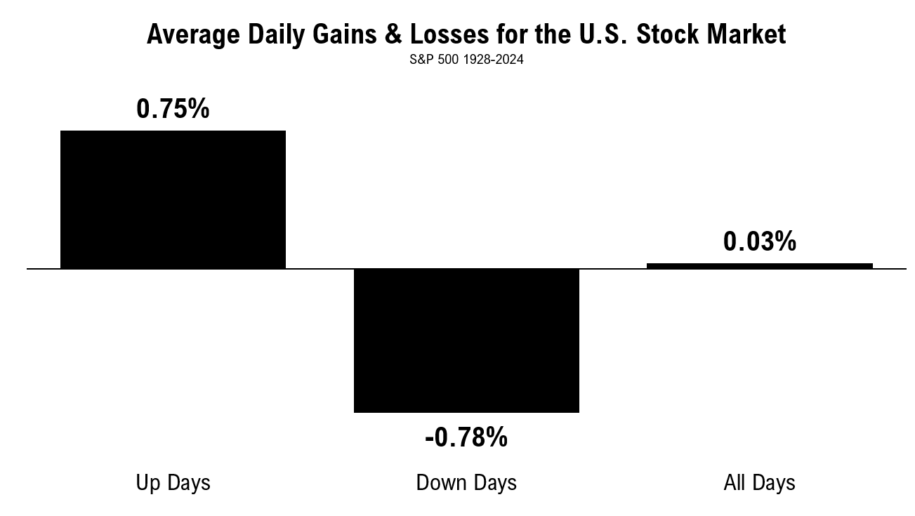
Feeling Terrible Every Day
Notes:
54% on a daily basis is basically a toss up
Gains and losses are essentially the same
If you look at the stock market daily that means you’re going to feel terrible every single day
Why?
If the losses hurt 2x as bad as the gains feel good all of the pleasure you would gain from seeing positive results will be subsumed by the despair you feel from losses
Myopic loss aversion - the more often you look the worse you’ll feel
Ignore the noise is great advice
And it’s completely impossible to follow
Looking at these results is also a great reminder that successful investing is really about small edges in the short-run that compound over the long-run
Loss aversion is the most important concept in finance because losses impact your perception of risk and how you invest but gains can mess w/your brain chemistry too

Slide 10
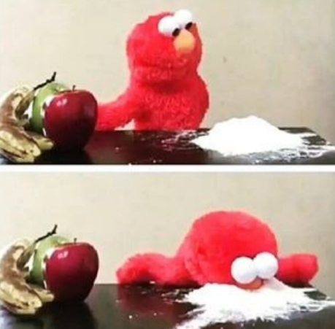
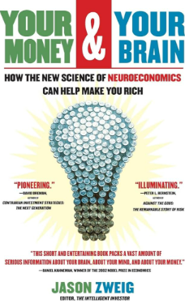
Cocaine Brain
Notes:
In Your Money & Your Brain, Jason Zweig explores how your brain influences and responds to financial decisions and outcomes.
Brain scans reveal that the neurological response to making money on investments is nearly identical to that of a person high on cocaine or morphine.

Slide 11
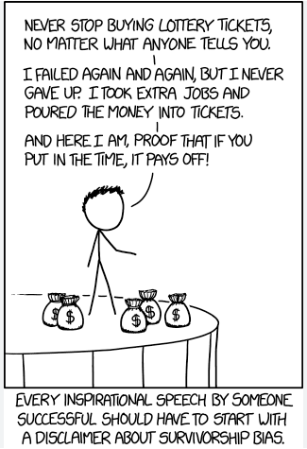
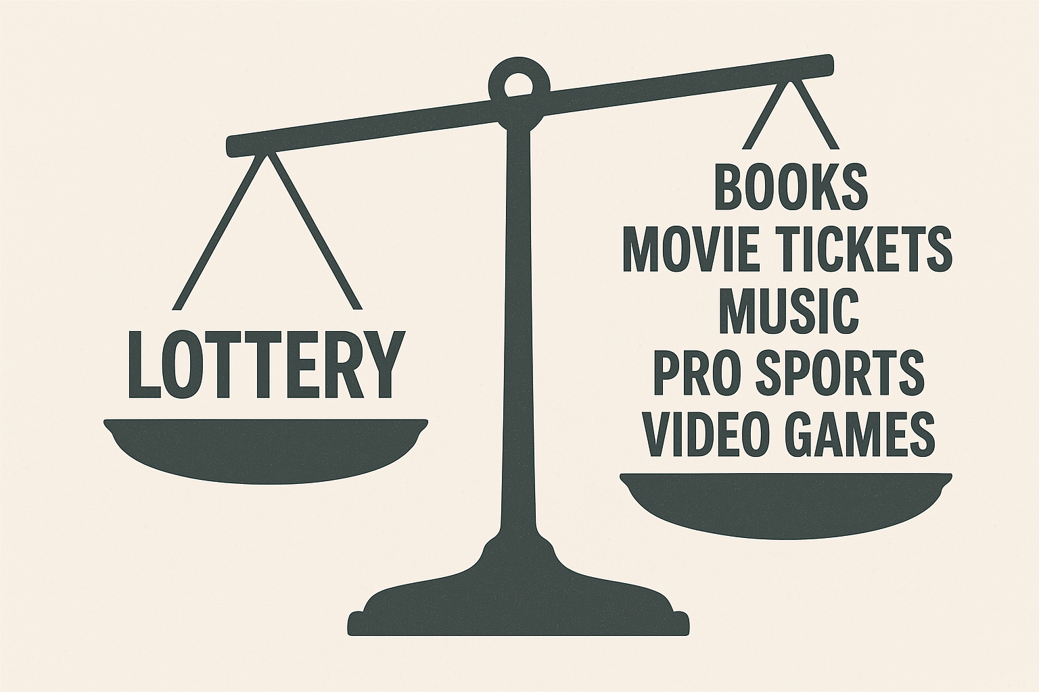
The Lottery
Notes:
Getting that high from investment gains is one of the reasons investors seek lottery ticket-like payoffs
One of my favorite stats:
Each year Americans spend more money on money on the lottery than they do on movie tickets, music, professional sporting events, video games, and books combined.
A man in the 1970s who set out to find a lottery ticket ending with the number 48. He won using his lucky numbers.
When asked why he wanted that specific number on his ticket he replied, “I dreamed of the number 7 for seven straight nights. And 7 times 7 is 48.”
It’s not just your own gain that can play head games w/you
People who win the lottery see their neighbors have a higher chance of increasing their spending, take on more debt, put more money into speculative investments, and eventually file for bankruptcy.
Studies show people are willing to pay four times more for a lottery ticket if they can pick the numbers rather than a random selection.
The odds are the same either way but people like that feeling of control.
Investors have a tendency to want to grab the steering wheel to take more control during market downturns, often to their own detriment
Doing more often leads to subpar results, especially when emotions are high.
https://awealthofcommonsense.com/2025/04/misbehaving-in-a-volatile-market/

Slide 12
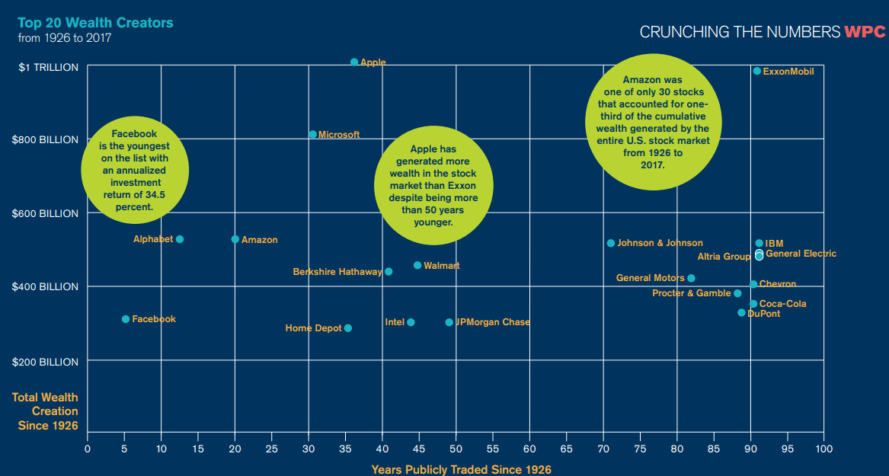
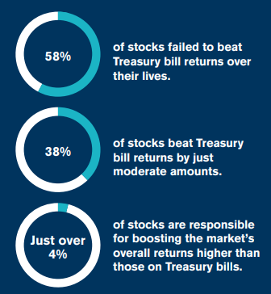
Power Laws
Notes:
Interestingly enough, the stock market exhibits lottery like payouts over the long haul
Hendrik Bessembinder performed one of my favorite stock market studies by looking at the biggest contributors to stock gains over the past 100 years or so
Bessimbinder found just 86 stocks accounted for half of all wealth creation in the U.S. stock market going back to 1926.
All of the wealth creation in that time came from just 4% of stocks – Apple, Amazon, Exxon, etc.
Nearly 60% of stocks failed to beat T-bill returns over their lives.
Close to 40% of stocks barely beat T-bills.
Just pick the best stocks right?
Good luck w/that
This study drives home the need for diversification more than ever – you need to cast a wide net to ensure you’ll be invested in those winning lottery tickets
More on diversification in a bit but I want to shift gears to talk about some of the other risks advisors are forced to reckon with

Slide 13
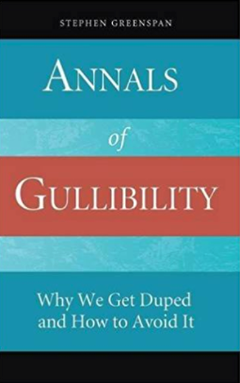
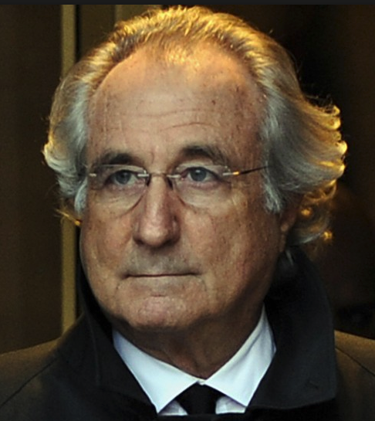
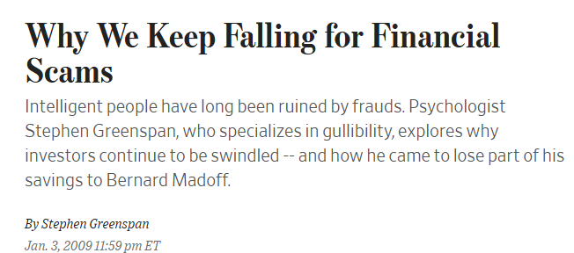
How Gullible Are You?
Notes:
Stephen Greenspan the foremost expert in the world on human gullibility
Subhead of the book: Why we get duped and how to avoid it
The book came in in December of 2008
It just so happens that’s the very same month Bernie Madoff’s multi-decade long Ponzi Scheme finally blew up and came to light
Good timing for Greenspan book sales, right?
Well it just so happens that Greenspan himself was an investor in Madoff’s Ponzi
The guy who was literally the world’s leading expert on human infallibility was duped in one of the worst investment scams of all-time
Why is this important?
Your clients are wealthy. They’re intelligent. They’re targets for scam artists, charlatans and their own bad decisions

Slide 14
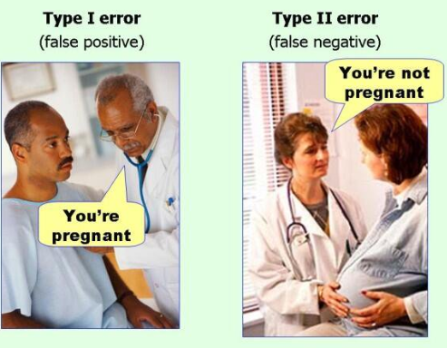
Type I & II Errors
Notes:
The information age is amazing for consumers of finance information but the firehose makes it harder to know who to trust
Remember this from stats class?
A type I error is when you reject a null hypothesis that is actually true.
A type II error is when you accept a null hypothesis that is actually false.
William Bernstein:
“The reason that 'guru' is such a popular word is because 'charlatan' is so hard to spell.”
I took the type I and II errors and applied to to charlatans

Slide 15
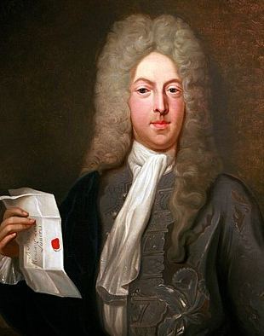
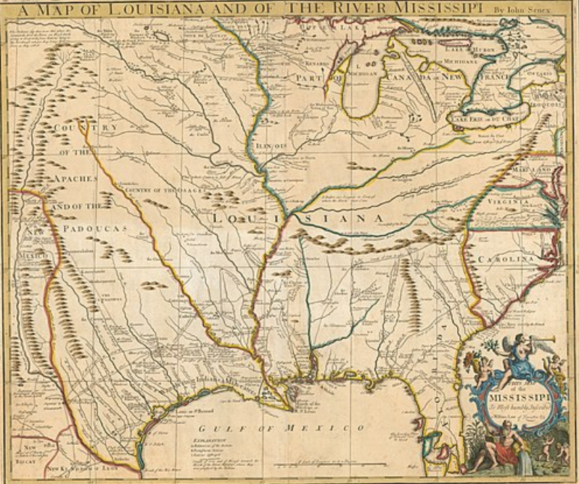
Type I Charlatans
Notes:
A Scotsman named John Law was basically the Magellan of the modern monetary system and France was his test case for a relatively new paper currency system.
France was on the verge of financial ruin from a combination of excessive debt levels from multiple wars and a corrupt King who spent far too lavishly.
Law proposed a shift from hard currencies such as gold and silver to paper currency
Paper money was rare at the time so to get buy-in from citizens Law set up a system to back that cash with government debt which could be converted into equity shares of a new exploration company.
That exploration venture, the Mississippi Company, was supposed to explore the Louisiana Territory and strike it rich by finding more gold and other precious metals
The problem is the company never lived up to its hype and more or less didn’t do what it was supposed to do.
Investors didn’t really care because share prices were rising based purely on speculation of what the company could become.
Law is a prototypical type I charlatan. He had complete faith in the system he was creating, going so far as reinvesting his own money into the scheme.
John Law was a visionary who was sincere but wound up ruining investors anyway, failing to take into account real-world dynamics or consider how his ideas could go horribly wrong.

Slide 16
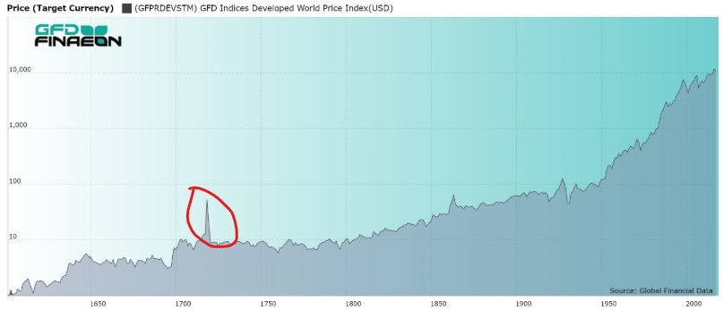
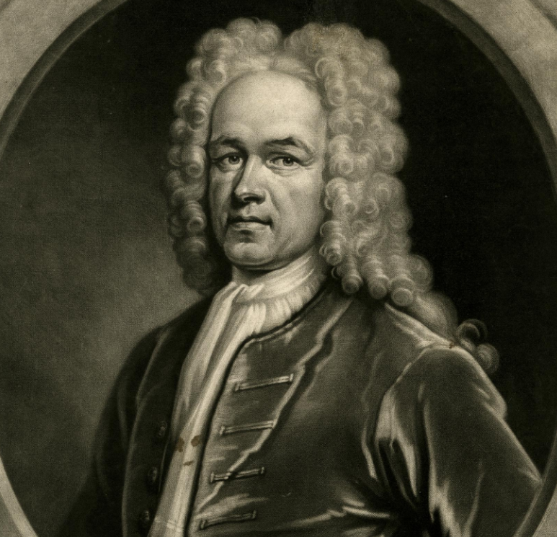
Type II Charlatans
Notes:
England saw what Law was doing and wanted in on the action
Enter the personification of the type II charlatan, John Blunt. Blunt had one aim in life – to become fabulously wealthy by any means necessary. And not only did he want to become rich, he wanted to become rich as fast as humanly possible
The South Sea Company was set up as a similar exploration scheme to the Mississippi Company to relieve England of their excessive war-time debts.
The biggest difference is Blunt essentially ran it as a pump-and-dump, spreading false rumors, bribing the courts, allocating shares to friends and family, pushing “investors” to utilize margin and forcing a lack of oversight as a director to the company.
The word bubble originated from the South Sea Company debacle

Slide 17
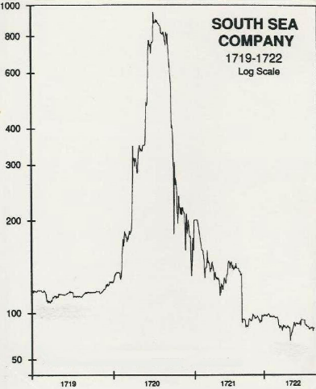
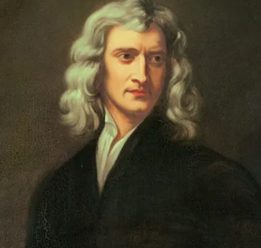
The Madness of People
Panic
Buy
Friends get rich
Sell…oof
Sell
Buy
Notes:
Isaac Newton is one of the smartest ppl to ever walk the planet
Contributions in mathematics, astronomy, physics, alchemy, theology, engineering, and technology make him arguably the most important figure of the scientific revolution
Not only was the man a world-renowned scientist, but he also took part in debates on monetary policy within the government and helped pursue counterfeiters in his work with the Royal Mint
By all accounts, Newton was a conservative, shrewd, and successful investor before the South Sea stock caught his fancy, investing prudently in mostly stocks and government bonds.
He lost 80%
Estimated to be around $20 million in today’s money
I guess you could say Newton discover the laws of gravity, am I right?
“I can calculate the motion of heavenly bodies, but not the madness of people”
He still retired a wealthy man but his ego was surely bruised
Newton was not a great market timer
This is one of my favorite topics

Slide 18
What if you only invested at market peaks?

Slide 19
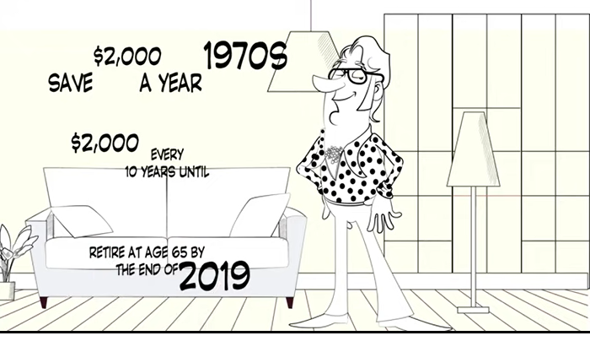
Bob’s saving strategy

Slide 20
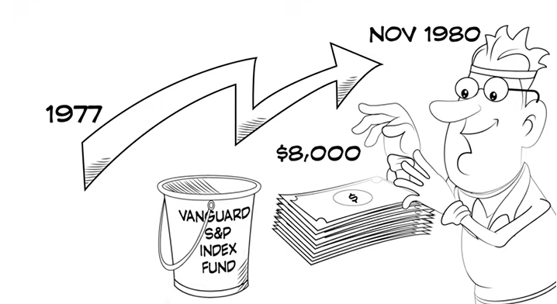
It’s time to invest

Slide 21
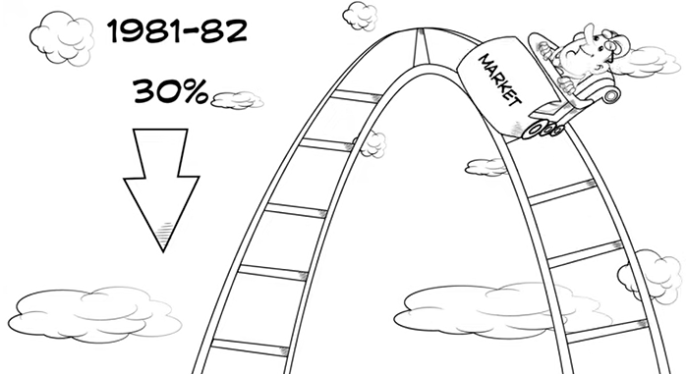
Bob’s 1st investment

Slide 22
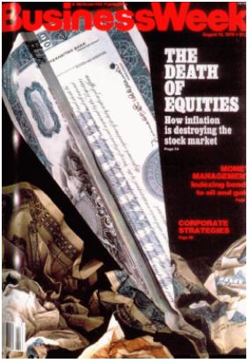
The death of equities

Slide 23
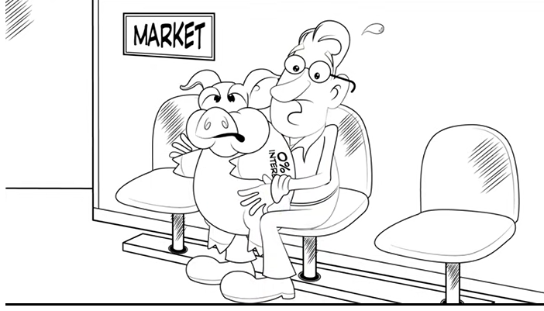
Bob was always nervous…
…but he did have one saving grace

Slide 24
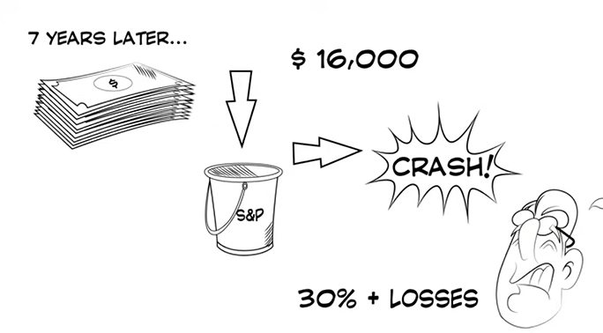
Bob’s 2nd investment

Slide 25
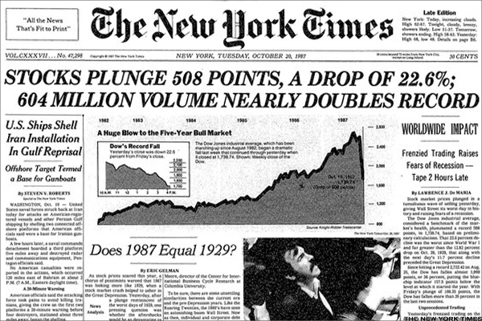
Black Monday

Slide 26
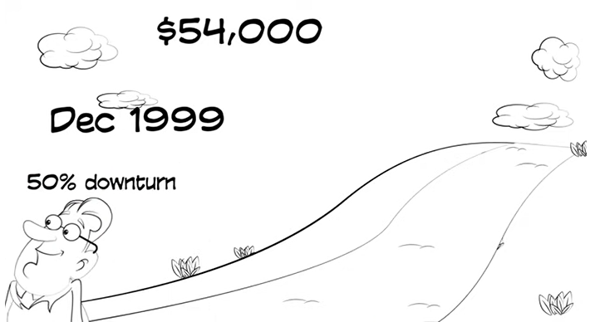
Bob’s 3rd investment

Slide 27
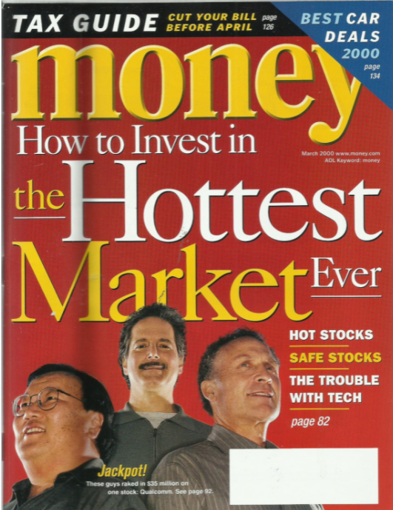
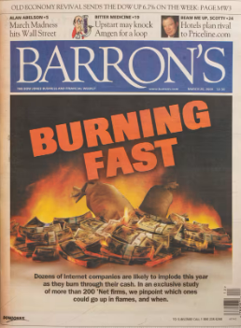
The dot-com crash

Slide 28
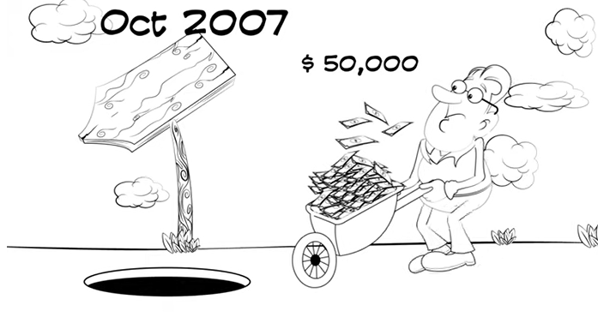
Bob’s 4th investment

Slide 29
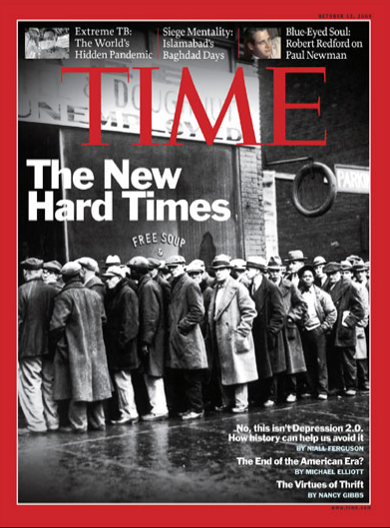
The Great Recession

Slide 30
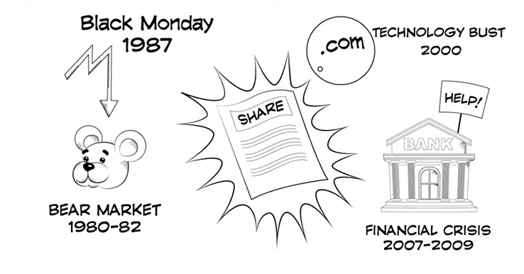
Bob always invested at the top

Slide 31
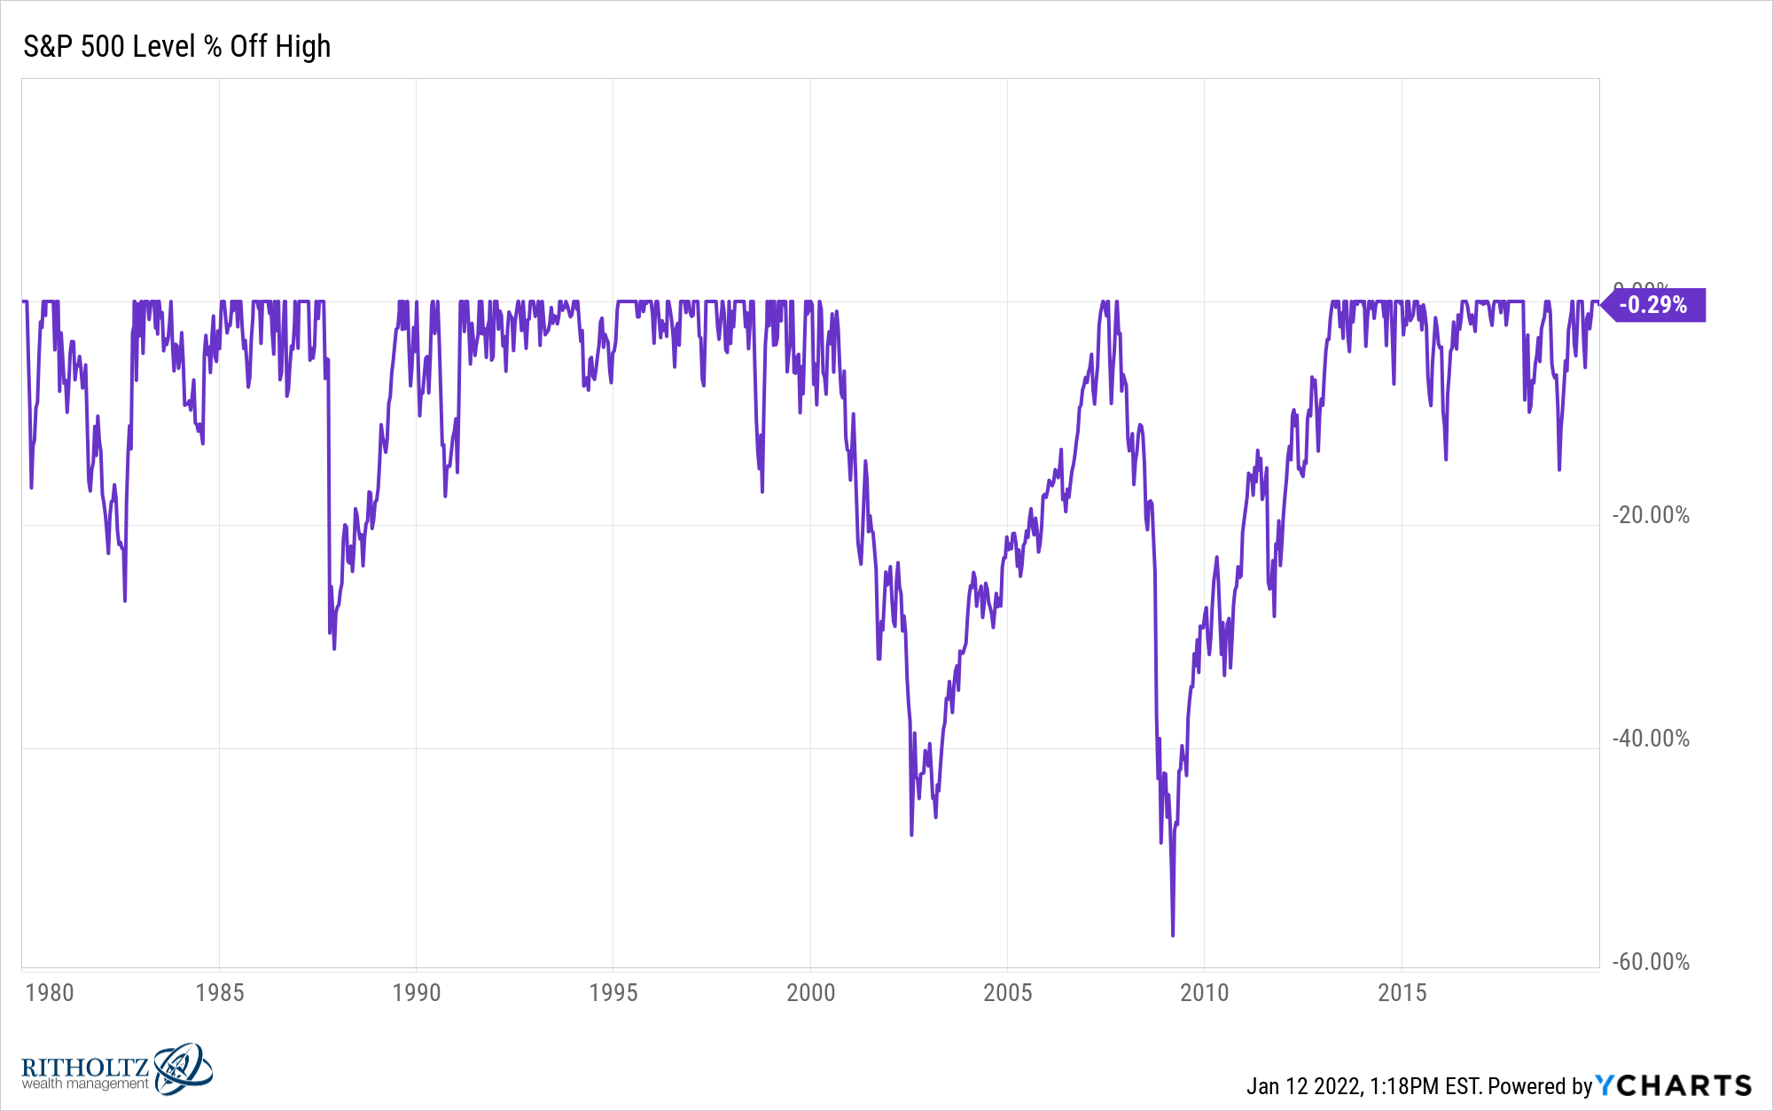
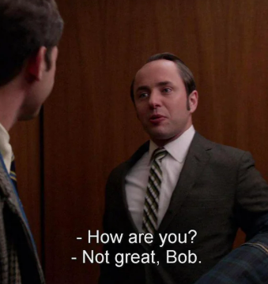
Bob invested before every crash
v

Slide 32
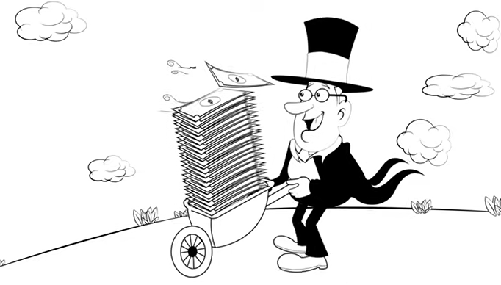
So how did he do?
$1.1 million
Notes:
$230k invested turned into $1 million (would be $1.7 million now)

Slide 33
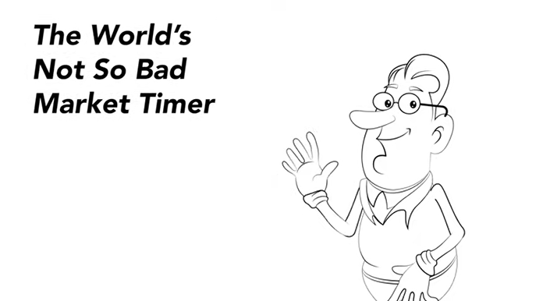
He never sold
He kept saving
He saved more over time
He had a long time horizon
Notes:
Easy right? Just hold. Easy for young investors who are building wealth. Financial advisors are mostly dealing w/clients who already built their wealth. Then what?

Slide 34
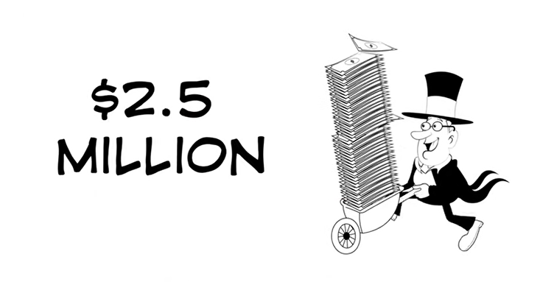
What if he didn’t get so nervous?

Slide 35
Managing Investments, Investors
and Behavior

Slide 36
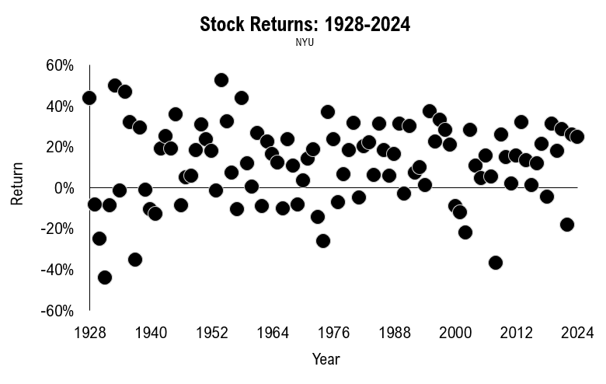
Stocks
Notes:
Stocks: 9.9% per year
Bonds: 4.5%
Cash: 3.3%
Investing is all about trade-offs and regret minimization
Do you want to minimize loss and volatility or minimize the chances of your living standards going down in the future?
Of course, for most ppl it’s a combination of the two

Slide 37
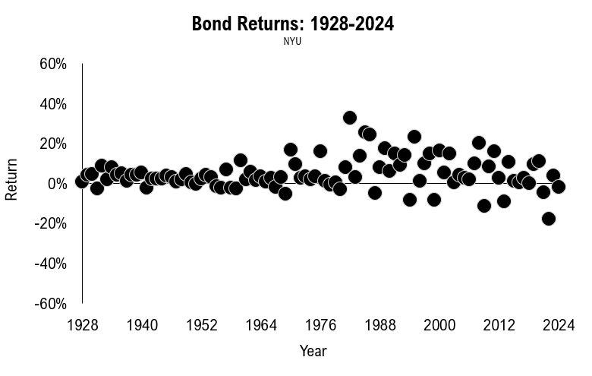
Bonds

Slide 38
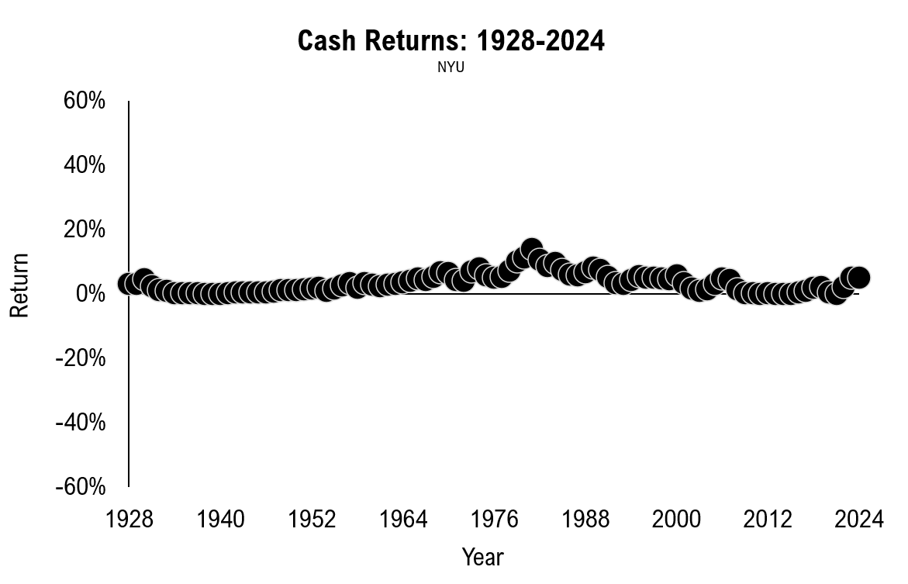
Cash

Slide 39
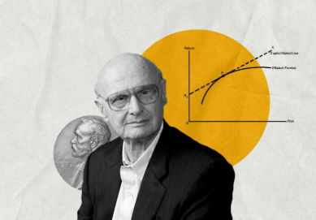
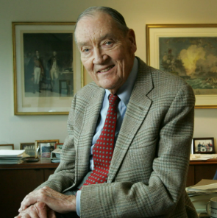
Modern Portfolio Theory
Notes:
Harry Markowitz put out his theory of Modern Portfolio Theory in 1952 for the Journal of Finance
I learned about Modern Portfolio Theory early in my career. My first boss was a huge proponent
You have to calculate variances and co-variances of different assets classes but the general idea is the importance of asset allocation and diversification to manage the risk of extreme outcomes on your portfolio

Slide 40
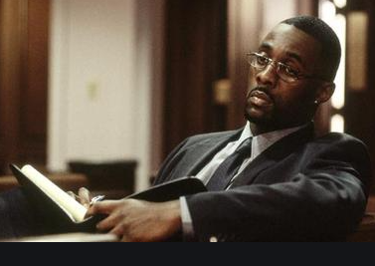
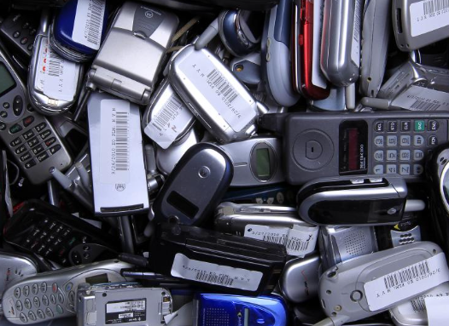
Diversification in The Wire
Notes:
Stringer Bell, the business mastermind of the Barksdale Organization in The Wire,
Burner phones.
Buy the burners are across multiple stores to avoid detection from a clerk at checkout
Each phone would have multiple SIM cards
He was avoiding police detection through diversification
the “game beyond the game”
An employees failed to diversify where he rented cars from which helped police break the gang and led to the downfall of the Barksdale organization

Slide 41
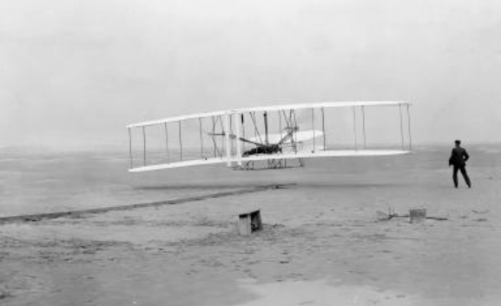
The Wright Brothers
Notes:
Just 5 ppl showed up to watch that famous flight on December 17, 1903
Hundreds of test runs before they finally got the flyer working correctly
Over four years, they faced skepticism, harsh weather, difficult conditions, injuries, remote locations, and crashes.
Wilbur once stated, “If one were looking for perfect safety, one would do well to sit on the fence and watch the birds. But if you really wish to learn, you must mount a machine and become acquainted with its tricks by actual trial.”
Still every test run they always brought tons of extra parts w/them b/c they knew a crash was always possible and even likely
The Wright Brothers practiced diversification

Slide 42
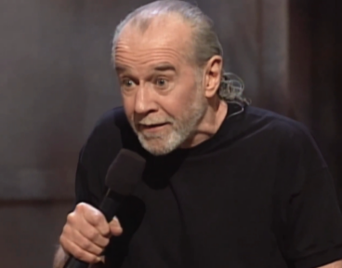
The Perfect Portfolio
Notes:
Markowitz was once asked how he constructs his own portfolio weights:
“I should have computed the historical co-variances of the asset classes and drawn an efficient frontier.”
But, he said, “I visualized my grief if the stock market went way up and I wasn’t in it — or if it went way down and I was completely in it. So I split my contributions 50/50 between stocks and bonds.”
Jack Bogle on his 50/50 portfolio:
But I confess that half of the time I worry that I have too much in equities, and the other half of the time that I don't have enough in equities

Slide 43
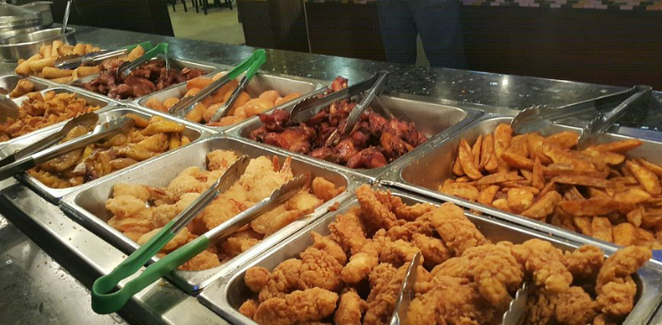
Eating at the Buffet
Notes:
Warren Buffett is 2 Ts
Researchers studied the dining behaviors of hundreds of patrons at Chinese buffets across the country to understand what influenced their consumption patterns.
Diners ate less when using chopsticks or smaller plates.
They consumed more when using forks and larger plates.
Healthier eaters surveyed the buffet before picking out what to eat, whereas unhealthy eaters grabbed everything they could fit onto their plates
Those sitting closer to the buffet ate more, while individuals facing away from the buffet line consumed much less.
Studies estimate that 95% of dieters eventually regain the weight they lost
The investing parallels here is that sometimes you need to face your chair away from the buffet
Define the stuff you won’t invest in
Automate good decisions ahead of time
It’s much harder to automate health than wealth

Slide 44
Context & Communication
Notes:
$140 million when I first joined the firm. $6 billion or so now
First big client found the firm through my blog
Individual bonds vs. bond funds
Drilled us w/questions for the first year or two
“I had a bunch of questions but you guys answered them all on the podcast”
Now we talk about our kids, family vacations and his dream of one day owning a country farm in Scotland
Not saying everyone needs to start a blog, podcast or youtube channel
But you do have to figure out a way to get your message across pre-emptively

Slide 45
The 11th Commandment
Notes:
Ppl don’t go to church on Sunday’s expecting to hear an 11th commandment
Sometimes we in the finance industry take for granted the fact that most ppl aren’t paying attention to this stuff as much as we are
Ppl need constant reminders of your philosophy
Drill it home
40k books about Abraham Lincoln
The Battle of the Bulge took place around 75 years ago. From 2014-2016 there were at least 8 books written on this one WWII battle.
World War I took place more than 100 years ago.
There were a half-dozen books, each hundreds and hundreds of pages, published in 2014 alone about why the Great War broke out in the first place.
Historians have given more than 200 hundred theories about what caused the fall of the Roman Empire.

Slide 46
Current Risks
Notes:
Anything going on in the markets today?
Nothing really worth talking about right?
I used that joke on a client call recently
I got a laugh

Slide 47
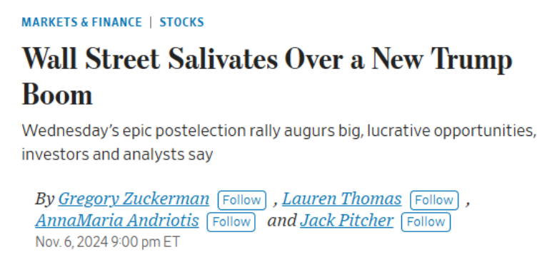
Life Comes At You Fast

Slide 48
Predictions About the Future

Slide 49
The Narrative Dance
Notes:
Not trying to dunk here. Good reminders. Life happens fast.

Slide 50
A Recession is Coming

Slide 51
Are You Ready?
Notes:
One recession in the past 15 years
It lasted 2 months, was man made and over in record time
Everyone is out of practice

Slide 52
A Bear Market is Coming

Slide 53
Margin of Safety?
Notes:
Every advisor has two types of clients:
Some ppl lean into the pain
Some ppl are losing their faith at the moment
Don’t go to extremes. Change your allocation
80/20 to 70/30 or 60/40
Plenty of gains to harvest if you have ppl who are worried
No shame in that for certain clients

Slide 54
Waiting for the Dust to Settle
Notes:
Waiting for the dust to settle is not an investment strategy
Remember this one from the pandemic?
The stock market was rocketing higher in April 2020 as the unemployment rate was screaming higher (14%)
The stock market is forward looking
It doesn’t care about good or bad – it’s better or worse that matter

Slide 55
Predictions About the Future

Slide 56
Timing Recessions

Slide 57
Volatility is a Feature, Not a Bug

Slide 58
Volatility Depends on Time Horizon

Slide 59
Your True Risk
Am I on track to achieve
my financial goals?
2. How do I minimize the risk of
not achieving my financial goals?

Slide 60
The Only Question That Matters
Am I going to be OK?

Slide 62
Questions?

Slide 63
Sign Out Code:
2113
SCAN THE ABOVE QR CODE BEFORE AND AFTER EACH PRESENTATION TO GET CE CREDIT

