Slide 1
Financial Planning for Widowed Clients:
What Every Advisor Needs to Know
(to retain clients)
Chris Bentley, CFP®, CLU®, CRPC®, BFA™, MBA
Wings for Widows, Founder | Executive Director
WidowWise LLC, Managing Partner
All-Ohio Symposium
April 29, 2025
Notes:
Good Afternoon!
Thank you, FPA Central Ohio, for inviting me to be with you today. It’s great to see so many of you.
To set the scene for our discussion, let me start with the problem.
NEXT

Slide 2
PROBLEM: The Dual Failure
Business Failure
70% of widows leave their financial advisor within 12 months of their spouse's death¹
Average client acquisition cost: $3,119 per client²
Opportunity cost: $75,000+ in lost revenue per departed widow (15-year client relationship)³
Women projected to control $34 trillion in assets by 2030 (38% of investable wealth)⁴
¹Vanguard; Financial Advisor; Kiplinger
²Kitces Research; Kitces
³Based on a 1% fee on average $500,000 AUM multiplied by 15 years post-loss; Unbiased
⁴Bloomberg; Yahoo Finance; Empower
Notes:
The financial services industry faces a profound business and ethical failure in its approach to widowed clients.
The business implications are staggering - despite spending over $3,000 to acquire each client, firms lose 70% of their widowed clients within a year of their spouse's death.
With women outliving men by an average of 15 years and the significant wealth transfer currently underway and growing, this represents billions in forfeited revenue industry-wide.
NEXT

Slide 3
PROBLEM: The Dual Failure
Ethical Failure
Abandonment during a critical life transition and emotional vulnerability
Failure to establish trust with both spouses during the relationship
Inadequate preparation and protocols for supporting clients through grief
Lack of specialized training to address widows' unique emotional and practical needs
Notes:
Even more concerning is the ethical dimension. At precisely the moment when widows, and to a lesser extent widowers, are most vulnerable and in need of trusted guidance, the industry fails them. We fail them.
Advisors build relationships primarily with male spouses, leaving widows feeling disconnected when they need support the most. Research shows many firms lack specialized training to address widowed clients' unique emotional, mental, financial, and practical needs during their transition.
Common complaints from widows who leave include: "I hardly knew him, he mainly spoke to my husband” and "He didn't really listen to me, and I felt patronized when I asked questions.“
This dual failure persists despite harming the financial advisory business and the clients it claims to serve. It suggests deep gaps in advisor training and service models that require real solutions rather than superficial fixes. The service delivery model for widowed people is broken; it has been for decades, and it isn’t improving. The good news is you each have the power to make it better.
(Question) How many of you recall your last training about working with widowed clients? (Exactly)
You can earn your CDFA and certainly advocate for your divorcing client, but the attorneys have the primary relationships. They’re in the driver’s seat. However, when it comes to working with widowed clients who are experiencing profound loss and financial upheaval, where you are the primary advisor, there is no accreditation. There is no training. There are no service models. I’ve seen a few checklists, but little else.
Fortunately, I am not a widower. But after working with thousands of widowed men and women, you learn a thing or two. I hope to share some of that with you to help you work better with your widowed clients so you can retain them.
NEXT

Slide 4
PROBLEM: The Financial Impact
The Business Case: Retention vs. Acquisition
Cost of Losing Widowed Clients:
$3,119 in acquisition costs already spent per lost client
$5,000 annual revenue from average $500,000 AUM client (1% fee)
$75,000 lost revenue over a 15-year relationship period
Nearly $80,000 total cost per lost client
Benefits of Retention:
Redirect some of the 20% of time spent pursuing new clients
Just 2-3 additional hours in the first year can dramatically improve retention
Improving retention from 30% to 80% yields a 167% increase in lifetime value
Additional referral potential from well-served widowed clients
Notes:
How does this impact you?
Let’s break down the financial impact to your practice.
The business case becomes pretty clear when we examine the financial implications of the widow retention problem. On the cost side, using the previous numbers and factoring in the cost of acquiring a client, we're approaching $80,000 in combined costs and lost revenue for each widow who leaves.
CLICK
The benefits of retention are equally compelling. Rather than continuing to invest 20% of advisor time in pursuit of new clients, reallocating just 2-3 additional hours per widowed client during their first year of transition could dramatically improve retention rates.
If a practice could shift from the industry average of 30% retention to 80% retention, the return on that time investment would be extraordinary - a 167% increase in lifetime client value, when you do the math.
This doesn't account for the referral potential from well-served widowed clients.
The business case should be clear: investing a modest amount of additional time to support widowed clients through their transition adequately yields a return measured in tens of thousands of dollars per retained client relationship. It’s worth it to do it right.
NEXT
Calculation to get 167%:
If we start with a 30% retention rate and improve to 80% retention rate for widowed clients, here's what the math looks like:
For every 10 widowed clients:
At 30% retention: 3 clients stay, 7 leave
At 80% retention: 8 clients stay, 2 leave
Looking at lifetime value:
30% retention: 3 clients × $75,000 = $225,000 lifetime revenue
80% retention: 8 clients × $75,000 = $600,000 lifetime revenue
The increase in lifetime value is: ($600,000 - $225,000) ÷ $225,000 = 1.67 or 167% increase

Slide 5
In an industry intrigued with figures and forecasts, we often overlook the profound emotional and financial turmoil faced by newly widowed clients. Financial advisors must embrace a transformative approach, recognizing that true client satisfaction and retention are achieved through empathy and understanding.
- Chris Bentley
Notes:
You may be a widow or widower; if so, I’m so sorry for your loss. I hope you’ll say hello after the presentation.
By a show of hands, how many know someone who has been widowed?
How many are working or have worked with widowed clients in your practice?
So, it’s probably safe to say that we all know people who have lost a spouse.
But how well do we really understand them? How well do we comprehend the process of widowhood, what they go through, and what they need from YOU, their financial advisor?
Over the next few minutes, I will try to enlighten you.
NEXT

Slide 6
AGENDA
The Widow Crisis
Widowhood’s Unique Challenges
Financial Impact of Loss
Transforming Your Approach
Essential Advice
Resources
Notes:
Here’s our agenda.
We’ll begin by understanding the full scope of what I call "The Widow Crisis" – a systemic failure affecting millions of men and women.
We'll then explore the unique emotional, cognitive, and practical challenges presented by widowhood, which traditional advisory approaches often fail to address.
Then, we’ll examine the "Financial Impact of Loss" to understand how widowhood affects a family's financial health.
This leads us to the heart of the presentation: enhancing your practice by transforming your approach with widowed clients to dramatically improve retention while providing truly meaningful and memorable service.
We’ll discuss age-specific guidance that advisors should provide when working with newly widowed clients. This is critical because providing the right guidance at the right time establishes value and trust, whether there was a previous relationship with the client or not.
We'll conclude by sharing valuable resources to help you develop expertise in this underserved area.
By the end of today's presentation, you'll have practical strategies to transform both your service model and your business results when working with widowed clients.
Let’s get started with a story.
NEXT

Slide 7
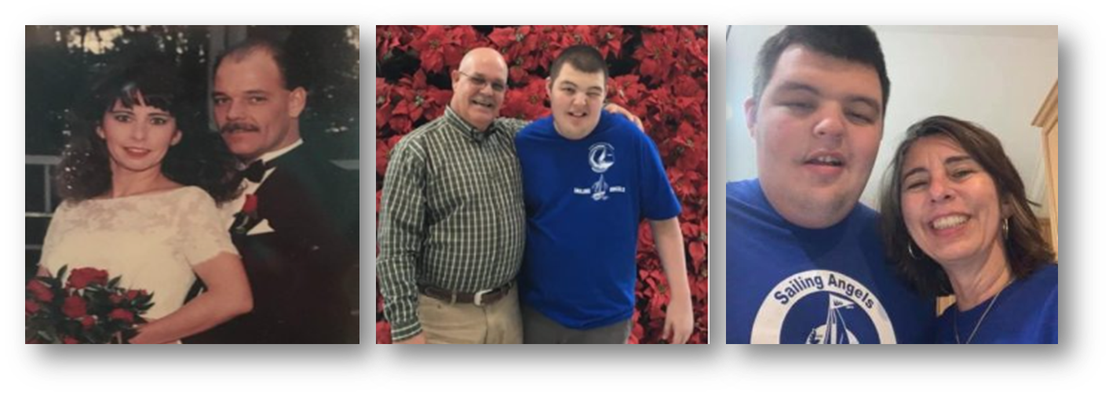
Maria’s Story
I couldn’t have done it without Don. In the end, I knew what I needed to do, and he really helped me move forward with such a hard decision. The equestrian property was the dream for John and me. Now my new dream is to be financially stable.
Notes:
Happily married for 25 years, Maria and John lived in their dream home on a modest equestrian property.
All three of their children were grown, but one of their sons, Jake, remained at home full-time under Maria’s care due to severe disabilities.
While John was the family’s sole income earner, he prioritized being involved at home. He was an integral part of Jake’s day-to-day life, and they were very close.
When John passed away suddenly in 2021, while doing chores around the property, Maria and Jake’s worlds were shaken to the core.
Now the sole caretaker of Jake, Maria was reliant on Medicare and survivor benefits as well as a small life insurance policy from John as the family’s only sources of income.
She quickly found herself unable to keep up financially, and eventually, their home’s mortgage went into forbearance.
Maria knew that she needed to do something about their finances, but in addition to her own shock and grief, her number one priority was getting Jake stabilized after losing his father.
We’ll come back to Maria’s story a little later.
NEXT

Slide 8
The “Widow Crisis”
Approximately 3,000 women become widowed every day in the U.S.¹
70% of all married women will face widowhood²
The average age of a widow is 59³
Widows live 15 years longer than their husbands, on average⁴
Widows outnumber widowers 4:1⁵
80% of men die married; 80% of women die single⁶
Almost half of all widows earn less than $25,000 a year⁷
Widowhood is often a ticket to poverty⁸
About 60% of elderly poor women are widows⁹
¹U.S. Census Bureau (2020-2022); ²Nadia Karamcheva and Alicia H. Munnell, "Why are widows so poor?" Center for Retirement Research (July 2017); ³Impact Report. Modern Widows Club. 2020 and Rethinking65's research on widowhood (2022); ⁴Kiplinger; ⁵Jrank: ⁶Kiplinger and USAFacts and Statista; ⁷NCOA; ⁸NCOA; ⁹The Gerontologist journal article on "Economic Consequences of Widowhood" (2001)
Notes:
The widow crisis represents a significant and often invisible demographic challenge in America. While widowhood affects approximately 7% of our population – both men and women – today we'll focus primarily on widows due to their disproportionate representation and unique financial vulnerabilities.
The statistics paint a stark picture of widowhood – the club nobody wants to join.
Approximately one and a half million Americans become widowed every year, with about 3,000 women joining these ranks daily – that's one new widow every 28 seconds.
The current population of widowed individuals in the U.S. is approximately 15 million. Perhaps most surprising is that widowhood isn’t just for the elderly – the average age of a widow is just 59, with these women typically outliving their husbands by another 15 years.
Women's longer lifespans create a significant gender imbalance, with widows outnumbering widowers 4-to-1. In fact, 80% of men die married; 80% of women die single.
But the most alarming statistics relate to financial security. Almost half of all widows earn less than $25,000 annually, effectively making widowhood a potential ticket to poverty for many. This is reflected in the fact that about 60% of elderly poor women are widows.
These numbers underscore why addressing the widow crisis isn't just a business opportunity but a social imperative.
With 70% of all married women, including those in this room, eventually facing widowhood, there is no shortage of widows to assist. That’s why it’s essential to develop expertise in serving this fragile population effectively.
NEXT

Slide 9
Widowhood’s Impact
Notes:
These sobering statistics from the 2020 Modern Widows Club Survey reveal widowhood's devastating cognitive, financial, legal, and practical impacts.
“Brain fog" experienced by 91% of widows surveyed—lasting two years or more—directly affects critical decision-making when 69% feel forced to make financial choices they're unprepared for.
What is brain fog or “widow fog?” It’s the physiological response to loss and grief. It can be debilitating. The brain just doesn’t work right, especially the memory function.
It’s responsible for
Forgetfulness​
Inability to focus​
Irritability​
Fatigue​
Numbness ​
Irrationality, even​
Nausea ​
This cognitive impairment occurs precisely when widows face complex challenges: 33% develop new health conditions, 44% need legal help, and 29% must enter, or re-enter, the workforce.
For advisors, understanding this is crucial—widows aren't simply experiencing emotional grief, but profound cognitive impairment and other challenges that require specialized support during this critical transition period.
NEXT

Slide 10
The Financial Impact of Loss
Income for survivors drops an average of 37% in the three years after a spouse's death compared with the three years prior.
- Source: Federal Reserve Bank of Chicago, May 2020
Notes:
The loss of a spouse can be crippling—emotionally, physically, spiritually, socially, and especially financially.
For many widowed individuals, the ache for financial stability and security is a constant companion as they navigate their new reality.
Let’s look at the financial impact of losing a spouse.
NEXT

Slide 11
The Financial Impact of Loss
Income reduction: declines 37-50% after loss of spouse¹
Social Security cut: surviving spouse receives only the higher of two benefits, not both²
Healthcare costs: 15% lose health insurance entirely; 18% face coverage changes³
New health challenges: 33% diagnosed with new mental/physical health issues within the first year⁴
Childcare burden: Single parents pay an average of 36% of their income vs. 10% for dual-income households⁵
Credit score and auto insurance impact: credit scores often decline⁶, and insurance premiums often increase⁷
Estate settlement costs: legal fees and probate expenses⁸
“Widow Tax” effect: higher brackets despite lower income⁹
¹WISER, "Widowhood: Why Women Need to Talk About This Issue," 2019; ²Social Security Administration; ³Modern Widows Club Survey, 2020; ⁴Modern Widows Club Survey, 2020; ⁵U.S. Department of Labor, 2024: ⁶Center for Retirement Research and FedWeek; ⁷Money and Zebra.com; ⁸SMPA Law and Lawyers.com; ⁹Kiplinger, 2024
Notes:
This cascade of financial challenges creates the perfect storm for newly widowed clients, striking precisely when their decision-making capacity is most compromised.
The 33-50% drop in household income coincides with potential increases in healthcare costs, childcare expenses, and tax obligations, to name just a few.
As financial advisors, we have a unique opportunity to provide critical support during this transition.
By proactively addressing these financial challenges with sensitivity, you demonstrate value that addresses their most pressing concerns. More importantly, you build trust.
Failing to recognize these unique needs is precisely why 70% of widows change advisors within a year.
All widows are subject to the “Widow Tax.” You may be familiar with this, but let’s look at an example.
NEXT

Slide 12
The Widow Tax
Meet Roberto and Dorothy, retirees
Four adult children
Residence: Florida
Roberto: 74​
Dorothy: 70​
Roberto passed away in December 2019
Description | 2019
Filing Status | Joint
Income from IRAs | $100,000
Roberto’s Social Security benefit | $30,000
Dorothy’s Social Security benefit | $20,000
Total Income | $150,000
Total Federal Tax | $17,700
Notes:
Let me tell you about Roberto and Dorothy, residents of Florida. ​
Roberto was an accountant and Dorothy was a nurse. They have 4 adult children.
Roberto’s health began to decline soon after retiring; Dorothy spent a year taking care of him until he passed away in December 2019.​
In 2019, their financial situation looked like this:
CLICK
Income from IRAs (RMD): $100,000
Roberto’s Social Security benefit - $30,000
Dorothy’s Social Security benefit - $20,000
Total Income - $150,000
Total Federal Tax - $17,700
No State Tax in FL
NEXT

Slide 13
The “Widow Tax”
Description | 2019 | 2020
Filing Status | Joint | Single
Income from IRAs | $100,000 | $100,000
Roberto’s Social Security benefit | $30,000 | $0
Dorothy’s Social Security benefit | $20,000 | $30,000
Total Income | $150,000 | $130,000
Total Federal Tax | $17,700 | $21,300
Loss of income: $20,000
Increase in taxes: $3,600
Notes:
So, what changed for Dorothy, now a widow, when she files for the year after Roberto died?
There were no minor children, so Dorothy’s filing status is now Single.
Income from IRA – still $100,000
Roberto’s Social Security benefit - now ZERO
Dorothy’s Social Security benefit – now $30,000 with the surviving spouse benefit step-up
You can see:
Total Income dropped to - $130,000
Total Federal Tax increased to - $21,300
CLICK
That’s a reduction of at least $23,600 due to Roberto’s death.
Two things are fueling this:
1. The standard deduction gets cut in half. This means that Dorothy will be left with less tax-free income.
2. The tax brackets are smaller. $130,00 of taxable income puts a married couple in the 22% bracket vs. the 24% bracket as a single filer.
This is “The Widow Tax,” also known as the Penalty Tax. Why do we penalize people for losing a spouse? It’s a bad deal for widowed people and you need to be aware of it.

Slide 14
The “Solo Parent” Challenge
Financial Strain
Emotional Stress
Parenting Responsibilities
Sources: Childhood Bereavement Network, Wiley Online Library, and Statista
Notes:
When a parent passes away, the surviving spouse doesn't just grieve the loss of a partner—they also face the daunting task of single-handedly managing the household, finances, and the emotional well-being of their children.​ They become “solo parents.”
Solo parents often experience a significant overlap between financial strain, emotional stress, and parenting responsibilities.
The financial burdens of single-parent households can really add to the emotional distress, and the emotional toll of managing grief and parenting simultaneously can negatively impact their ability to manage finances effectively. The situation becomes overwhelming and can lead to a cycle of stress, affecting both the parent's well-being and the children's development.
Studies show that 75% of widowed parents encounter unexpected financial burdens, and a significant number experience severe psychological distress, including depression and anxiety, even PTSD.
As financial advisors, it's crucial to recognize these compounded challenges. Providing appropriate support that addresses both the financial and emotional needs of widowed clients with minor children can make a profound difference in their journey toward healing and financial stability.
NEXT

Slide 15
Widowhood’s Unique Challenges
Emotional Turmoil – Grief clouds judgment, making even basic financial decisions feel overwhelming.
Inexperience with Finances – 86% of widows were not the primary financial decision-maker.
Sudden Financial Shock – Loss of income, pension, or benefits can destabilize everything.
Navigating Complex Benefits – Life insurance, Social Security, COBRA, pensions—each with high-stakes deadlines.
Estate & Legal Complications – Probate, wills, and legal notifications often catch them off guard.
Insurance Overhaul – Understanding and updating multiple insurance types requires urgent attention.
Vulnerability to Exploitation – Scams, predatory sales, and poor advice are serious risks in early grief.
Adjusting to New Roles – Widows take over tax prep, investments, and home maintenance.
Revised Estate Planning Needs – New guardianships, trusts, and beneficiary designations are essential.
Rebuilding Support & Confidence – Widows must regain emotional and financial footing, often from scratch.
Notes:
Are you getting a clearer picture of widowhood?
A newly widowed client is NOT your typical client. Their challenges are different, and the stakes are higher.
If Barbara was a client before she lost her husband, she’s a very different client after the loss.
Understanding the emotional load they carry is critical to serving them well.
And grief isn't the only thing they’re managing, right? Look at this list! They're navigating healthcare, pensions, probate, filing claims, legal paperwork, home maintenance, and childcare—sometimes all in the same week. Should anyone be asked to tackle all this, alone, during the most stressful time in their lives?
And with 86% having never made these decisions before, they are in crisis, and they desperately need you for guidance and support.
NEXT

Slide 16
69% of widowed people said that becoming the sole financial decision-maker was the biggest challenge of widowhood.
– Source: Merrill Lynch / Age Wave study
Notes:
When I say, 'widowhood is the club nobody wants to join,’ you get it, right? And yet, 70% of widowed individuals go through this without any professional support.
This was the impetus for Wings for Widows – I believed then, and still do, that all widowed people should have access to professional financial advice when they need it the most, whether they can afford it or not. To make sure no one has to face all this alone.
So, when working with YOUR newly widowed clients, you must recognize that it is far from "business as usual."
This means you will wear many hats in the relationship. If you don’t, or decide not to, you will likely see that client leave you for someone who is.
NEXT

Slide 17
Building Blocks of a New Approach
Thoughtful Education
Adjusting Communications
Sensitivity
Empathy
Proactive Planning
Consistency
Patience
Comprehensive Support
Notes:
Now that we’ve explored how widowhood changes everything, let’s talk about how financial advisors can show up differently—because a widowed client is not your typical client.
We need a new approach:
And not just a softer tone—this is rethinking the advisor role altogether. The most effective advisors blend technical expertise with emotional intelligence. What you say matters, but how you say it often matters more.
Let’s walk through the building blocks of this new approach.
🔹 Adjusting Communication means tailoring the pace and structure of your meetings. Think shorter, more focused conversations. Be willing to meet at their home. Morning meetings are often better. Provide meeting summaries with clear follow-up action items.
🔹 Thoughtful Education is about breaking complex ideas into digestible steps. Widowed clients are learning while grieving—don’t flood them with jargon. Use visual aids, timelines, and checklists to make information easier to understand.
🔹 Sensitivity is knowing what not to say. It’s about reading cues, avoiding pressure, and recognizing emotional triggers. This helps your client feel safe—not judged or rushed.
🔸 Proactive Planning means helping them see around corners. They may not know what questions to ask—so anticipate the road ahead. Help them plan and build the next chapter.
🔸 Comprehensive Support goes beyond investments. It includes helping with benefits, budgeting, insurance, and even home maintenance or family decisions. Bring in outside professionals when needed. Play quarterback and get them the help they need.
🔸 Consistency builds trust over time. Keep your word. Show up when you say you will. Stay steady through the chaos. Widows remember who followed through—and who didn’t.
🔹 Patience allows space for silence and tears. You may need to repeat information more than once. That’s not a lack of understanding—it’s a sign of overload. Be okay with going slowly. Proceed at their pace, not yours.
🔹 And at the foundation—Empathy. This isn’t just sympathy or being nice. It’s tuning in emotionally, putting yourself in their shoes. It’s being present, remaining calm and reassuring, and putting their needs ahead of your agenda. It’s the one skill that holds all the others together.
If you lead with these building blocks, you won’t just retain a client—you’ll help rebuild a life. And that, more than any portfolio allocation, is what earns loyalty and referrals.
Because at the heart of all of this—empathy, consistency, sensitivity—is trust. And trust is the foundation for long-term relationships, deeper engagement, and truly meaningful work.
NEXT

Slide 18
The Right Advice at the Right Time
Crisis Planning: Stabilization
Cash Flow
Asset & Banking Access
Will & Probate
Social Security Benefits
Bills, Debts & Creditors
Traditional Planning: Optimization
Investments
Retirement Planning
Ownership Transfers
Legal Documents
Insurance Adjustments
Tax Planning
Every client is different. Pace matters. Prioritize what matters to them right now—not what’s standard in your process. Trust builds through timing as much as expertise.
Notes:
Now that you have an approach for working with newly widowed clients, let’s talk about what kind of advice you should be giving—and when.
Most financial advisors start where they’re most comfortable: the portfolio. When I was practicing, I went there first—to reduce risk, enhance income, and so on. All with the best intentions. I didn’t know differently.
But that’s the wrong place to begin with a grieving client.
Early-stage widowhood is a financial crisis, and in a crisis, you don’t start with optimization. You start with stabilization.
That’s what we do at Wings for Widows. We address their most pressing needs and stop the bleeding. We get them stabilized.
So, initially, think Emergency Room. Think crisis triage.
This is why Crisis Planning must come first. It’s reactive, short-term, and focused on the urgent. What the widow really wants to know is: ‘Will I be okay?’
What that translates to is: ‘Do I have any income?’ ‘Do I have cash?’ ‘Can I pay the bills?’
Addressing these immediate needs is where your value is. If you solve for that, you relieve fear. You build trust. You earn the right to do comprehensive planning later.
Think of it like driving in fog. They don’t need a roadmap for the next 10 years. They need headlights for the next 10 feet.
Once you’ve brought them out of the fog, then—and only then—can you safely transition into longer-term financial planning.
So, on the left, we’re answering the question: Will I be okay?
On the right, we’re guiding them toward long-term financial independence. Absolutely important, but not a priority in the beginning.
If you can help them feel safe and stable in the short term, you’ll earn their trust for the long term.
NEXT
Now that we have an approach for working with newly widowed clients, let’s talk about a better strategy for providing them financial advice. At least initially.
Crisis Planning is reactive and focuses on dealing with immediate financial emergencies or unexpected events, like losing a spouse. This type of planning is short-term and aims to mitigate the immediate impact of the crisis. For your newly widowed clients, this is job ONE. You need to do financial triage to treat the crisis.
Financial Planning, as you know, is a comprehensive, ongoing process that involves strategizing to meet long-term financial goals. Great. You do this everyday. For widowed clients, this is necessary, but NOT until they’ve resolved the immediate crisis.
It makes sense to combine crisis planning with financial planning to address both urgent and less-urgent topics. A financial advisor should focus on crisis planning to stabilize the client's financial situation. Once the immediate needs are met, the advisor can transition to broader financial planning topics to secure the client's long-term financial well-being. (It’s like driving in fog…)
We could debate what is a higher priority topic. Every situation is different and, indeed, investments may be more important to some than to others. What we have found is that cash-flow is #1. The big question is, "Will I be okay," and what they mean is, "Do I have any income?" “Do I have any money?” Answering this question as soon as possible provides some immediate relief.
If creditors are circling to get paid, this can't be put off. Managing creditors and debt is #2 in importance, if applicable. And so on.
IF NECESSARY
[Immediate Needs (Urgent Topics):
Cash Flow - Immediate Needs: Ensure the widow has immediate liquidity for expenses such as funeral costs and daily living. This involves promptly accessing various accounts like checking, savings, and retirement accounts that may have cash or liquid assets.
Bill Payments and Financial Obligations: Set up systems to continue regular payments, possibly automating routine bills and reassessing immediate financial obligations to prevent late fees or credit issues.
Social Security and Other Benefits: Assist with applications or adjustments for Social Security benefits, life insurance payouts, annuity benefits, and any veterans' benefits. This ensures a continuation of income streams and leverages available financial supports.
Understanding the Deceased's Will and Probate Process: Collaborate with an estate planning attorney to understand the will's directives and initiate the probate process, which will legally transfer asset ownership and ensure adherence to the deceased's wishes.
Updating Bank Account Information: Update banking and financial service records to reflect the widow's sole ownership or to add trusted family members if needed for financial management.
Longer-Term Planning (Less Urgent Topics):
Investments & Retirement Accounts: Evaluate the spouse's investment and retirement strategies, making adjustments to align with the widow's current situation and future financial goals.
Ownership Transfer: Work with legal professionals to transfer the ownership of assets such as real estate, vehicles, or business interests as dictated by estate plans or probate outcomes.
Estate Planning and Legal Documentation: Update the widow's estate plan including wills, powers of attorney, healthcare proxies, and beneficiary designations to reflect the new circumstances.
Insurance: Review and adjust insurance policies, ensuring the widow has adequate coverage for health, home, auto, and life without the deceased spouse.
Taxes: Prepare for potential tax implications due to changes in income, filing status, and estate valuation, seeking the assistance of a tax professional to navigate complex tax matters.]
These topics should be approached with sensitivity and at a pace comfortable for your client, recognizing that their capacity to make decisions can be affected by grief and stress. It's also important to provide ample time for them to process information and avoid pressuring them into hasty decisions. Advisors should act as a resource and guide, helping the widowed navigate through these complex and emotional decisions.

Slide 19
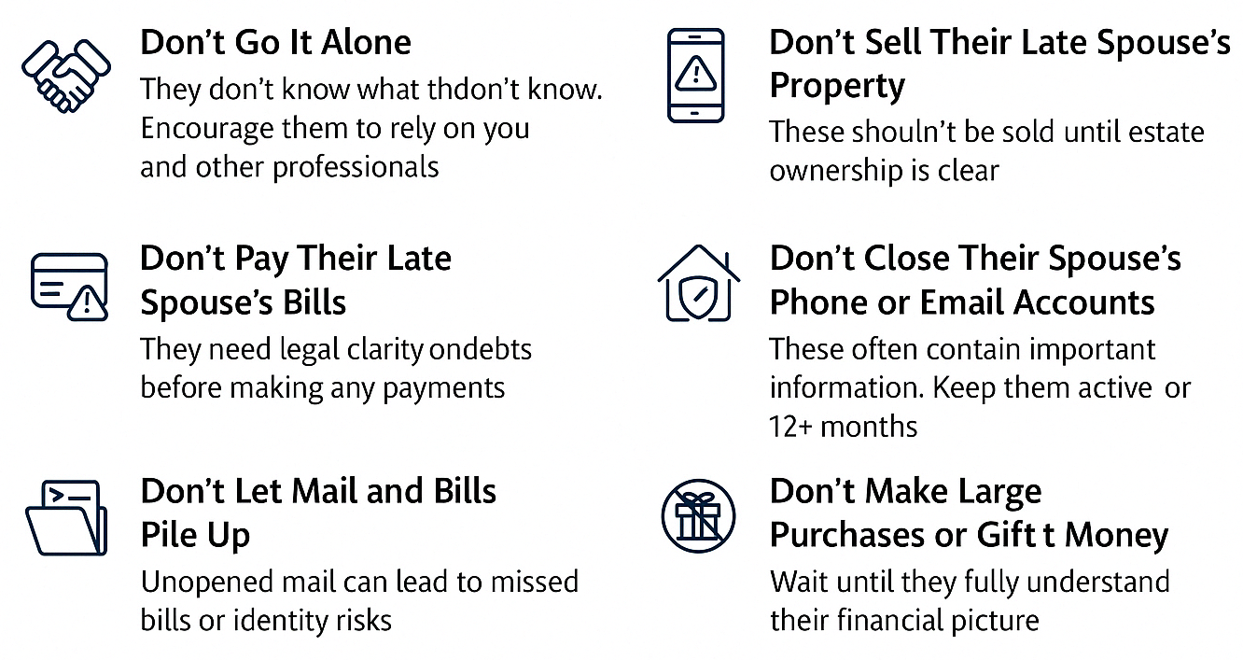
Start Smart: What Not To Do
Notes:
When working with newly widowed clients, one of the most helpful starter conversations you can have early on is about what NOT to do. These aren’t just legal or financial mistakes—they’re often emotional mistakes, if you will - decisions made in a fog that can have negative consequences.
Let’s walk through 6 key things to help your client avoid:
Don’t Go It Alone. Encourage them to lean on you and other professionals—they don’t know what they don’t know. Let them know you’re available 24/7. Have them reach out to you, not staff – remember, it’s worth your time! So, make the time.
Don’t Pay Their Spouse’s Bills. These may not be their responsibility. Always check with an estate attorney first. They always have questions about who’s responsible for medical bills after a loss – in most cases, the surviving spouse is unless the charges were put on a credit card owned by the decedent or paid with a loan owned by the decedent. Otherwise, it’s considered a joint debt.
BTW, Don’t Use Their Spouse’s Credit or Debit Cards. It feels harmless, but it’s illegal and could complicate the estate.
Don’t Let the Mail Pile Up. Missed bills, notices, or forms can lead to late fees or lost benefits. Daily mail review is essential. (Story: Almost missed the COBRA letter!)
Don’t Sell Spouse’s Property Right Away. Cars, collectibles, or real estate—hold off until ownership is legally transferred to you.
Don’t Close the Phone or Email Accounts. These may contain vital photos, contacts, or login credentials. Keep them active for at least 6 months.
Don’t Make Large Purchases or Gifts. Until they know where they stand financially, all spending should pause.
Each of these gives you a chance to protect your client and build lasting trust by being the guide they didn’t know they needed.
NEXT

Slide 20
Key Advice for Widows With Children
Immediate Financial Stability
Create a 12-24 month cash flow plan addressing childcare costs, housing decisions, and career transition needs
Insurance & Benefits Maximization
Review and optimize life insurance proceeds, Social Security survivor benefits, and employer death benefits
Career & Education Planning
Develop pathways back to the workforce, including skills assessment, education funding, and childcare solutions
Multi-generational Family Needs
Address diverse needs across the family spectrum: from guardianship for minors to college funding and support for adult children
Housing & Relocation Strategy
Analyze the affordability of the current home versus the benefits of relocating, including family support networks
Notes:
Widows in the 30-45 age range face unique challenges, often juggling multiple life stages simultaneously. Their financial journey typically involves rebuilding financial security while supporting children who may range from toddlers to college students or even adult children.
Your first priority should be establishing immediate financial stability. Help create a 12-24 month cash flow plan that addresses fundamental questions about housing, income, and essential expenses during this transition period.
Insurance and benefits maximization may be critical. These clients often have substantial life insurance proceeds but need guidance on structuring these assets for both immediate needs and long-term security. Social Security survivor benefits for minor children can provide crucial monthly income until they turn 18 (or 19 if still in high school), but many widowed clients don't realize these benefits exist.
Career planning takes on new urgency, especially for those who reduced workforce participation to focus on family. Your guidance on educational investments, childcare solutions, and building earning potential becomes invaluable in creating sustainable independence.
The multi-generational nature of these families requires nuanced planning. For those with minor children, guardianship planning is essential—addressing the critical "What if something happens to me?" question. For those with college-aged children, education funding strategies may need immediate revision. And for those with adult children, boundaries around financial support must be established while the widow secures her future.
Housing decisions balance emotional attachments against practical constraints. Your analysis should consider proximity to work opportunities, family support networks, school quality, and long-term affordability.
These clients need more than financial expertise—they need a compassionate partner who can help them envision and create an entirely new financial future while addressing their family’s diverse needs.
NEXT

Slide 21
Key Advice for Retirement-Age Widows
Investment Portfolio Restructuring
Create a three-tier strategy balancing immediate needs, income, and long-term growth while addressing shifted risk tolerance
Retirement Account Navigation
Review options; leverage unique spousal privileges while avoiding irreversible tax mistakes with inherited accounts
Social Security Optimization
Strategic timing between survivor benefits (age 60+) and personal benefits can yield $100,000+ additional lifetime income
Healthcare & Insurance Coverage
Develop appropriate bridge strategies for pre-Medicare widows and review long-term care planning
Estate Planning Updates
Review and update all beneficiary designations, powers of attorney, and digital asset access
Tax Planning Transitions
Capitalize on filing status, step-up opportunities, and home sale exclusion
Notes:
The median age of widowhood is around 59—and a significant majority of new widows are age 60 and above. That means most of the widowed clients we work with are at or near retirement. This segment brings a unique set of concerns—balancing security with longevity, making smart decisions with inherited retirement accounts, and figuring out how to navigate Social Security, healthcare, and the tax code.
Start with liquidity and cash flow and the other crisis planning topics, but know you’ll want to address these specific items for this age group sooner rather than later.
First, help them reassess investments based on their new life stage, including options regarding inherited retirement accounts, pensions, and annuities.
Guide them through survivor benefits and optimal claiming strategies, ensuring they understand their unique privileges as a surviving spouse.
Healthcare decisions may be urgent, especially for clients too young for Medicare. Know your COBRA, ACA, and Medicare timelines.
Estate planning often feels 'done' after probate—but in reality, everything must be updated: wills, beneficiaries, powers of attorney, and healthcare directives.
Finally, widows are often underprepared for taxes. Our Tax Hub is the #1 destination on our website from January through April every year. They are desperate for your advice and guidance here.
For widowed clients navigating this season of life, your role isn’t just about managing money—it’s about restoring confidence, preserving dignity, and helping them feel safe enough to move forward.
And remember: Widowed clients don’t need all the answers right away—they need someone to help them ask the right questions, in the right order, with patience and care.
NEXT

Slide 22
Key Tax Strategies for Widowed Clients
Roth Conversion Opportunity
Use joint filing status in the year of death to convert traditional IRAs at lower tax rates
Strategic Asset Disclaimer
Consider disclaiming inherited IRA assets to contingent beneficiaries in appropriate situations
Step-up in Basis Benefits
Leverage tax-free sales of appreciated assets to generate cash or rebalance investments
Home Sale Planning
Take advantage of the $500,000 capital gains exclusion window within two years of the spouse's death
Notes:
Let’s continue with taxes. While we've already discussed the "widow's tax,” several proactive tax strategies can significantly benefit your widowed clients.
You should understand that the year of death presents a valuable opportunity, as the surviving spouse can still file jointly.
This creates an ideal window for Roth conversions at lower tax rates, potentially saving substantial amounts over their lifetime while eliminating future RMDs that could trigger Medicare premium surcharges.
For clients with sufficient income from other sources, disclaiming inherited IRA assets to contingent beneficiaries (typically adult children) might make sense if those heirs are in lower tax brackets. Conversely, retaining the IRA and leaving taxable accounts to heirs may be preferable if children are in higher brackets.
The step-up in basis for taxable investments creates opportunities to sell appreciated inherited assets without triggering capital gains tax. This allows your client to raise cash if funds are needed for expenses or for diversification, if there were concentrated positions that might have been too costly to adjust previously due to large embedded gains.
Finally, remind clients about the home sale exclusion window. If they're considering selling their primary residence, they can exclude up to $500,000 in capital gains (versus $250,000 for single filers) if they sell within two years of their spouse's death. This can represent significant tax savings and should factor into housing transition timing decisions.
When you show up with empathy and clarity during this chapter, you’re not just providing solid advice and solving problems—you’re becoming the advisor they’ll trust for the rest of their life.
Let’s return to Maria’s story.
NEXT
Income-Related Monthly Adjustment Amounts (IRMAAs) are additional premium charges applied to Medicare Part B and Part D for higher-income beneficiaries. Let me explain how they work and provide an example of how Roth conversions can help avoid them:
Medicare Premium Surcharges Explained
Medicare Part B and Part D premiums increase when your Modified Adjusted Gross Income (MAGI) exceeds certain thresholds. These surcharges are called IRMAAs, and they're determined based on your tax return from two years prior.
Example of IRMAA Impact:
In 2025, a single filer with MAGI below $97,000 would pay the standard Medicare Part B premium (approximately $174.70/month). But if their MAGI exceeds this threshold, they enter the first IRMAA tier:
Standard premium: $174.70/month = $2,096/year
First IRMAA tier: $174.70 + $69.90 = $244.60/month = $2,935/year
Additional annual cost: $839
Higher income tiers face progressively larger surcharges, with the highest tier paying around $560/month for Part B (more than triple the standard premium).
RMDs and IRMAA Connection:
When a widow inherits her spouse's IRA and combines it with her own, the Required Minimum Distributions (RMDs) starting at age 73 could push her income into higher IRMAA brackets.
For example, a widow with:
$1,500,000 in combined traditional IRAs
Social Security of $35,000/year
Other income of $30,000/year
At age 73, her RMD would be approximately $54,750 ($1,500,000 ÷ 27.4 first year distribution factor). This pushes her total income to $119,750, potentially triggering IRMAA surcharges that could cost thousands in additional Medicare premiums annually.
Roth Conversion Strategy:
By converting some traditional IRA funds to Roth during the year of death while still filing jointly:
She pays taxes at lower joint filing rates
She reduces future RMDs from the traditional IRA
She avoids having Roth withdrawals count toward IRMAA calculations
This strategy requires careful planning about how much to convert each year, balancing immediate tax costs against long-term Medicare premium savings.

Slide 23
Maria’s Story
I couldn’t have done it without Don. Selling the property was such a hard decision, but he really helped me to see what I needed to do. The equestrian property was the dream for John and me. Now my new dream is to be financially stable.
Notes:
John has passed. Maria’s caring for Jake on her own. And the money is running out. Let’s pick up our story…
In early 2022, Maria heard a podcast about Wings for Widows and wondered if this was the help she needed. She contacted us and was paired with Don, one of our volunteer CFP coaches.
Maria began meeting with Don, taking inventory of all her finances. After accounting for the mortgage, the property’s up-keep expenses, and the cost of Jake’s care, Maria and Don found that she was going to be short about $50,000 every year if they stayed in their current home.
Selling your dream home and uprooting a disabled person is a difficult decision for anyone; in Maria’s case, Jake loved their horses, and riding was great therapy for him. Maria really struggled with what she knew, ultimately, she HAD to do.
Downsizing would allow her to pay off the mortgage, get out of debt, and continue staying at home to care for Jake – all without straining her finances. Maria and Don also found that there would be enough money left over, carefully invested, to pay for Jake’s care for the rest of his life.
CLICK
Today, Maria is so thankful for Don and how he approached her situation.
She said, “I never had to be defensive about anything. Don wasn’t judgmental. He just asked that I do the homework and then we would talk about possible next steps.
Don and Wings for Widows were precisely what I needed during the most stressful and challenging time in my life.”
This story had a happy outcome; many do not, unfortunately. You get to help write the endings of your clients’ stories. Work passionately to do so.
NEXT

Slide 24
Resources: Download My Free e-Book
SCAN THIS CODE
Notes:
Finally, there are resources for you if you want to learn more.
In my free 25-page eBook, "Navigating New Beginnings: A Financial Advisor's Guide to Supporting Widowed Clients," I explore the topics I shared today with specific advice, recommendations, and tasks that advisors should understand regarding their widowed clients.
Scan the code to download it.
NEXT

Slide 25
Resources: Purchase the Guidebook
SCAN THIS CODE
Notes:
The third edition of the “Newly Widowed Guide to Financial Wellness” was released in March this year. It’s on sale at Amazon now for thirty bucks if you care to purchase the authoritative guide on widow finance, addressing over 50 topics, including 14 worksheets, and a glossary. Nearly 300 pages. Every advisor should own a copy, and they make great gifts!
Scan the code to check it out.
NEXT

Slide 26
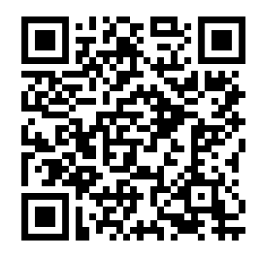
Resources: WidowWise University
SCAN THIS CODE
Notes:
As advisors working with widowed clients, you know they often need ongoing education and support between your meetings. WidowWise University is a resource you can offer directly to your clients to complement your professional guidance.
For just $19 per month or $99 for a whole year, your clients can access our comprehensive "Personal Finance for Widowed Men and Women" course.
This program covers over 50 essential financial topics tailored to the widowed experience, all presented in accessible formats including interactive worksheets, downloadable resources, and video shorts.
Consider gifting a subscription to newly widowed clients as part of your service offering. This provides them with immediate support and reinforces the education you provide during your sessions. It complements what you already do.
Many widowed individuals appreciate having a resource they can explore at their own pace, especially when processing complex financial information during grief.
NEXT

Slide 27
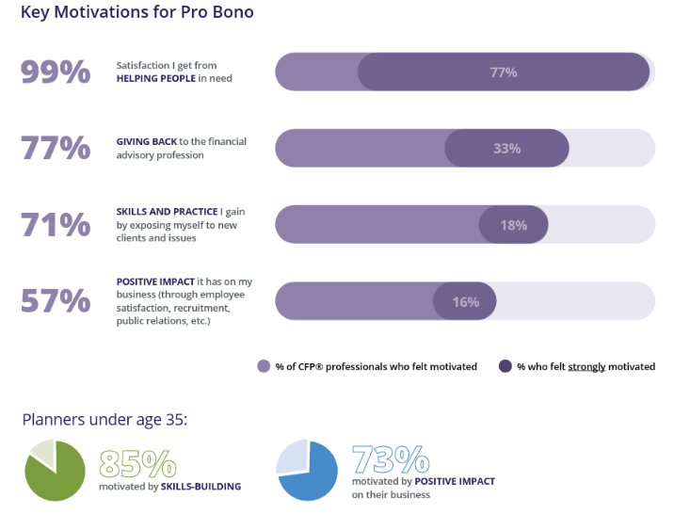
Pro Bono Financial Planning for Widows
Notes:
The Foundation for Financial Planning's survey of over 1,100 CFP® professionals in 2023 revealed the compelling benefits of pro bono service.
Nearly all CFPs find deep satisfaction helping those in need—99% —and 77% found satisfaction in giving back to our profession.
Beyond personal fulfillment, pro bono service develops valuable skills that enhance your practice:
71% gained experience with new client situations, and
81% of younger planners improved communication skills, which translates directly to better client relationships.
NEXT

Slide 28
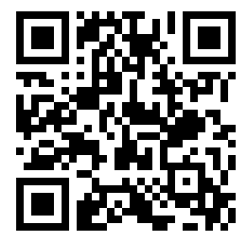
Resources: Become a Volunteer Coach
Make a meaningful difference in widows' lives using your financial expertise
Receive specialized training plus four hours of Continuing Education credit
Gain exclusive access to WidowWise University and all proprietary coaching materials
Join our growing network of over 100 dedicated CFP® coaches
SCAN THIS CODE
Notes:
By becoming a volunteer CFP® coach with Wings for Widows, you're not just giving back—you're investing in your professional growth, enhancing your practice, and joining a community of advisors committed to making a meaningful difference during one of life's most challenging transitions.
We provide comprehensive training that enhances your expertise while earning you valuable CE credits.
You will receive free access to WidowWise University and our proprietary coaching materials, which will give you the specialized knowledge and tools to guide your widowed clients through their financial journey with confidence.
You'll join a community of over 100 CFP professionals already making a difference, with new advisors joining our Financial Advisor Network weekly.
I encourage you to check out Wings for Widows by visiting our website. Scan the QR code to learn more about pro bono service and how you can support this rewarding mission.
NEXT

Slide 29
Questions
THE PURPOSE OF
HUMAN LIFE IS TO
SERVE AND TO SHOW
COMPASSION AND THE
WILL TO HELP OTHERS.
– A l b e r t S c h w e i t z e r
Thank You
www.wingsforwidows.org
Notes:
Why does working with widowed clients matter? Because the impact is both immediate and lasting. For the client and you.
When you guide someone from uncertainty to stability during one of life's most challenging and stressful events, you create exceptional value. The gratitude that follows builds unshakable trust and loyalty.
These relationships often transcend the typical advisor-client dynamic. The shared experience of navigating difficult decisions together creates connections marked by deep mutual respect. Many of the clients I worked with for years are now friends; I visit with them as often as possible.
From a practice perspective, widowed clients who receive compassionate, competent guidance tend to remain clients for life. More importantly, they become your most passionate advocates, sharing their experience with friends and family.
This isn't just about growing your business—it's about finding profound meaning in your work while making a tangible difference in people's lives. The investment of your expertise and genuine care enriches both your clients' futures and your own professional journey.
Thank you and good luck.
Questions?
CLICK FOR QRCs

Slide 30
Resources
SCAN THIS CODE
SCAN THIS CODE
SCAN THIS CODE
SCAN THIS CODE

