Slide 1
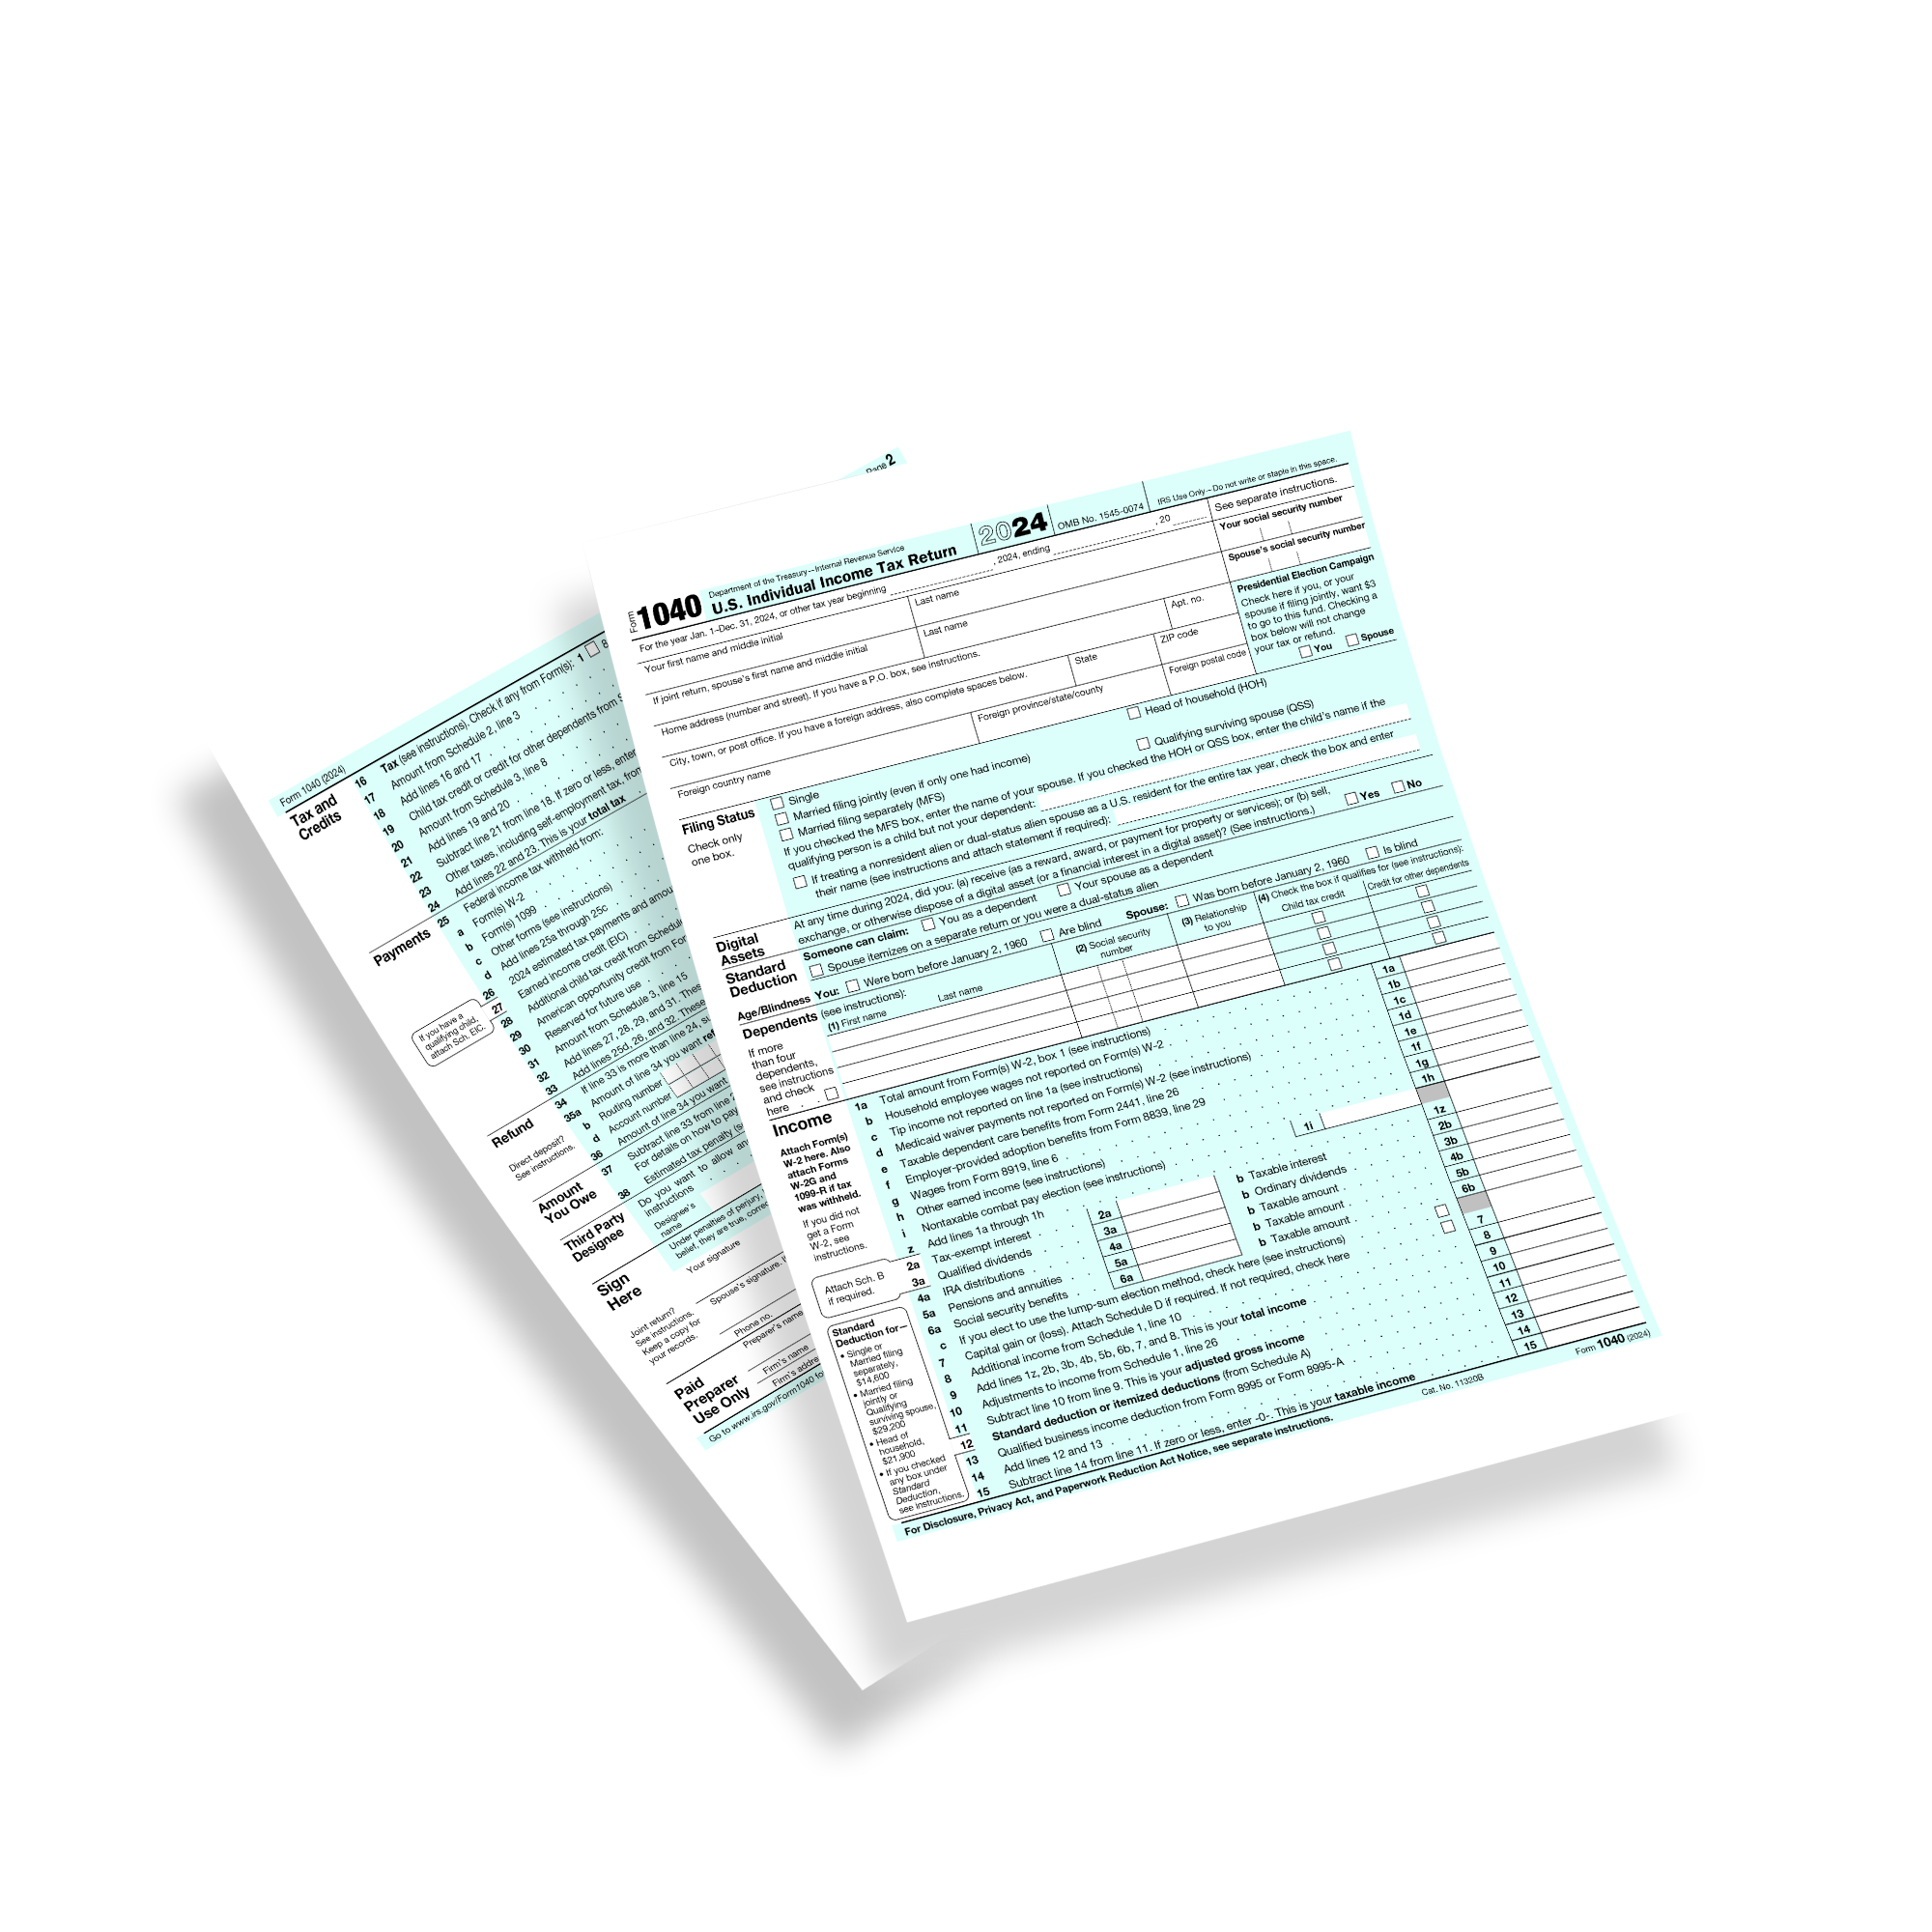
Tax planning amidst uncertainty:
how to deliver massive value on tax planning no matter what congress decides to do
Presented by:
Steven Jarvis, CPA

Slide 2
Steven Jarvis, CPA
CEO and Head CPA
Steven works exclusively with Financial Advisors and their Clients to help them not-overpay the IRS. His approach to combine tax preparation with tax planning makes him the CPA that Advisors and clients look forward to working with. Steven’s new book “Don’t Get Killed on Taxes” is available on Amazon and is a great example of the ways that Steven is working to educate taxpayers on tax planning.

Slide 3
Important
DISCLAIMERS
This is tax EDUCATION not tax ADVICE
This presentation is for professional audiences ONLY and should not be distributed to clients.
Courage and hard work are the foundations of all success.
This works!
While this passed our compliance department, YOU alone are responsible for being compliant.
Past performance is no guarantee of future results.

Slide 4
Learning Objectives
1
Understand the impacts of SECURE 2.0 that take effect (or have been clarified) in 2025
Learn the status of currently proposed bills and tax laws changes making their way through congress
Learn a framework for communicating with clients on tax planning in the midst of tax uncertainty
Determine which tax planning strategies can still help your clients while we wait for potential tax law changes to become more clear
2
3
4

Slide 5
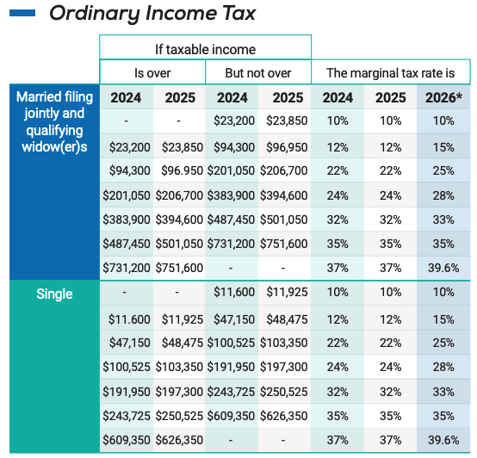
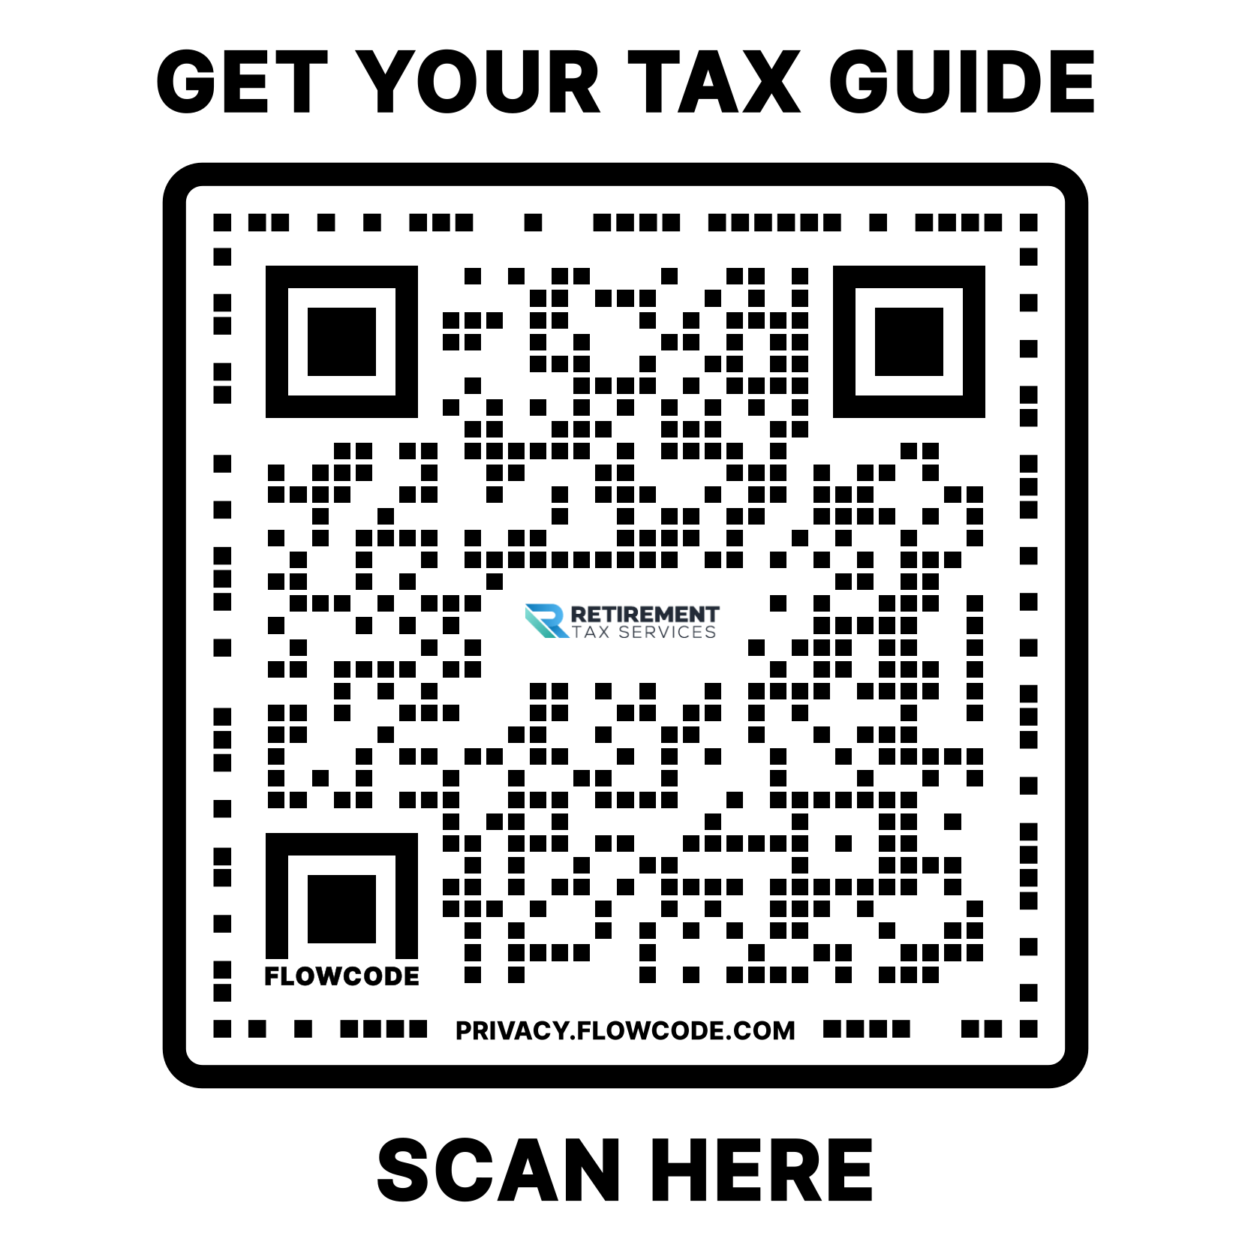
What we know today

Slide 6
SECURE 2.0 A FEW Key Reminders:
INHERITED IRA RMDS
For all clients with 2020+ non-spouse Inherited IRAs: “Mr & Mrs Client, the IRS has again changed the rules on IRA accounts. Unfortunately this means you will be required to take a distribution this year…”
RMD EDUCATION
For all clients age 68+: “Mr & Mrs Client, the IRS has again changed the rules on RMDs, for you specifically… (1950 or earlier, no change; 1951 to 1959…)
CONTRIBUTION LIMIT INCREASES
For all clients with earned income: “Mr & Mrs Client, as a result of recent rule changes from Congress you have the opportunity to put even more into your tax advantaged retirement accounts…”
ROTH OPTION IN QUALIFIED PLANS - WARNING
For all retirement plan participants and sponsors: “Though it will likely take months to be available, when employer Roth contributions become available, be warned that it will create phantom tax issues.”
529 ACCOUNTS INTO ROTHS
For all clients with heirs unable to make Roth contributions, especially those with 529 accounts: “We now have the ability to use 529 accounts as a quasi-Roth IRA. During our next meeting we will discuss…”
401K RULE CHANGES
For all retirement plan sponsors: “Dozens of new rules have been put into place, many of which will require additional IRS clarification. When your employees ask, explain that it can takes months or even years between when a law passes and the IRS is ready to implement.”
Expiration of TCJA in 2025…
Notes:
Auto enrollment and auto-escalation in 401(k) plans
Catchup contributions (50% increase for ages 60-63)
2026 - Catch-up contributions have to be Roth

Slide 7
529 to Roth
Has to be the same beneficiary
Counts towards annual contribution limits
Earned Income req.
Lifetime maximum of $35,000
15 year minimum
Plus 5 year kicker
Impact of changing beneficiaries on the 15 year minimum
How the $35k maximum is applied
Per account?
Per beneficiary?
Per taxpayer?
CLIENT: “Can I use a 529 for k-12 private school”
Restrictions
Unknowns (Unclears)

Slide 8
Will Congress do anything?

Slide 9
Will Congress do anything?
6 bills passed by the House of Representatives in the last month
H.R. 1152, the Electronic Filing and Payment Fairness Act
H.R. 998, the Internal Revenue Service Math and Taxpayer Help Act
H.R. 517, the Filing Relief for Natural Disasters Act
H.R. 1491, the Disaster-Related Extension of Deadlines Act
H.R. 997, the National Taxpayer Advocate Enhancement Act of 2025
H.R. 1155, the Recovery of Stolen Checks Act
Currently HUNDREDS of bills in both the House and Senate covering taxes…which is pretty standard

Slide 10
Taxpayer Assistance and Service Act (TAS)
Senate Finance Committee
Improving tax administration and customer service;
Creating fairness and simplification for millions of U.S. taxpayers living abroad;
Streamlining judicial review of adverse IRS determinations in several ways;
Strengthening the independence of the Office of the Taxpayer Advocate;
Authorizing the Treasury Department to establish minimum standards for tax return preparers;
Strengthening taxpayer rights before the Office of Appeals;
Setting forth rules relating to whistleblowers;
Providing filing and payment relief for U.S. taxpayers held hostage abroad who miss deadlines;
Providing administrative relief for small businesses; and
Certain miscellaneous changes.

Slide 11
Ways & Means Committee “Ideas”

Slide 12
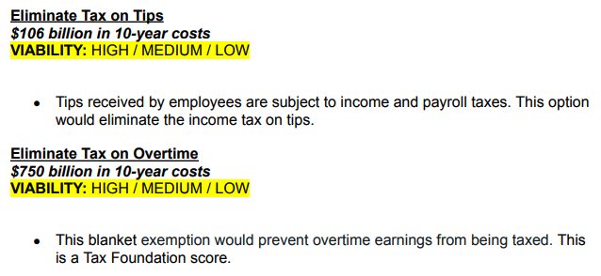
Ways & Means Committee “Ideas”

Slide 13
Ways & Means Committee “Ideas”

Slide 14
Ways & Means Committee “Ideas”

Slide 15
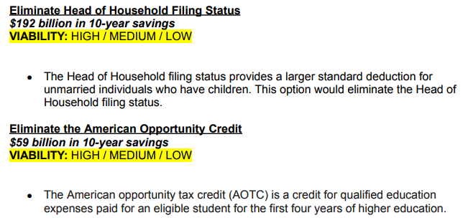
Ways & Means Committee “Ideas”

Slide 16
IRS

Slide 17
Tax laws can always change

Slide 18
“We have to make the best decisions based on the information and laws we currently have”

Slide 19
Tax Planning Can Still Happen (but patiently)
Eliminate surprises at tax time
Fund qualified accounts
Strategic charitable giving
“Are you concerned that tax rates might go up in the future?”
Plan for Roth conversions
Capital gains harvesting
What is different for this client this year?

Slide 20
The One Big Thing…
Request and review a copy of every client’s tax return every single year

Slide 21
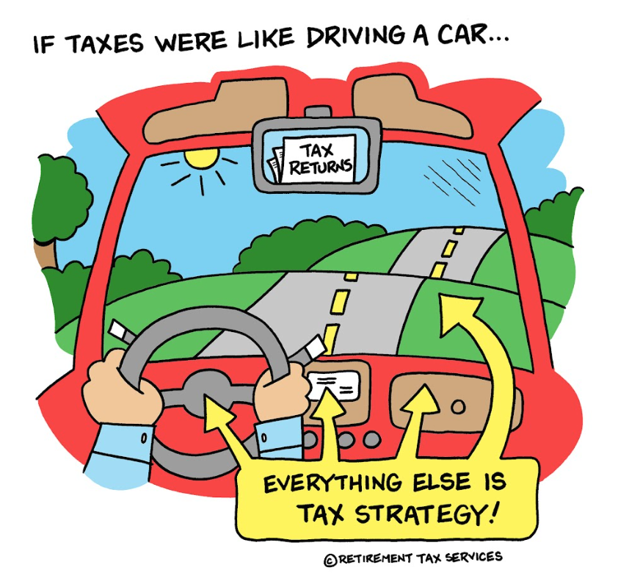

Slide 22
Where’s the line?
Tax Planning vs. Tax Advice

Slide 23
Learning Objectives
1
Understand the impacts of SECURE 2.0 that take effect (or have been clarified) in 2025
Learn the status of currently proposed bills and tax laws changes making their way through congress
Learn a framework for communicating with clients on tax planning in the midst of tax uncertainty
Determine which tax planning strategies can still help your clients while we wait for potential tax law changes to become more clear
2
3
4

Slide 24
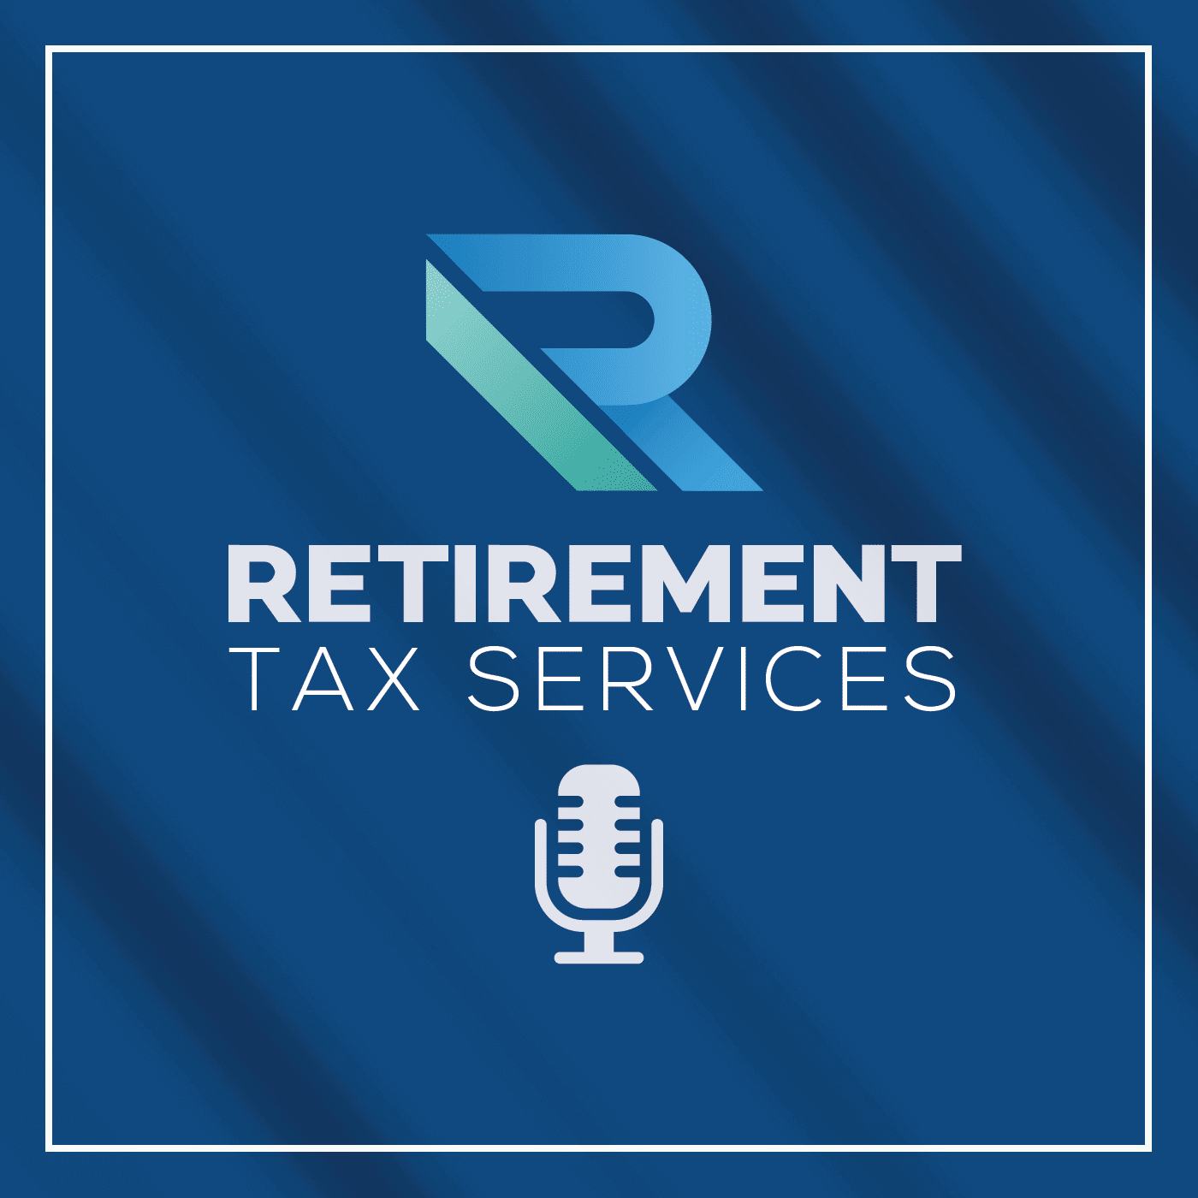
Thank You!
www.linkedin.com/in/stevenajarvis/
www.retirementtaxservices.com/podcasts/
https://www.youtube.com/@StevenJarvis-RTS
Remember to tip your Server, not the IRS!

